Slide 1
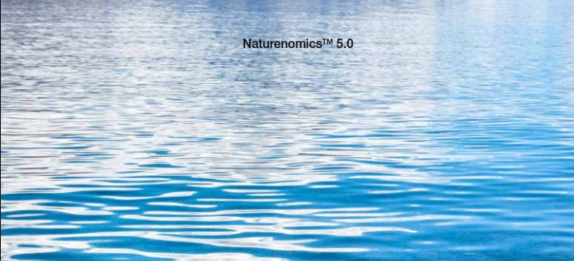
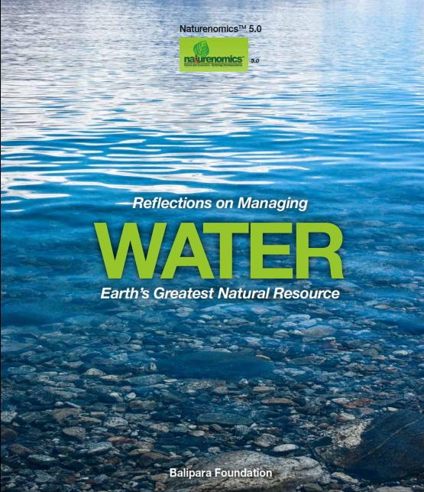

Slide 2

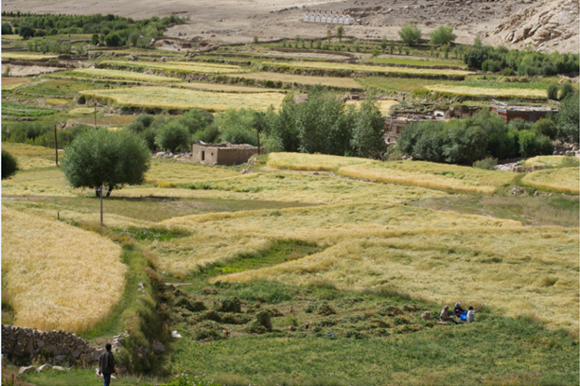
Relevance of book release today
Food security a global challenge
Food output must grow by 60 per cent to feed nine billion by 2050
But, by 2030, the world will confront a water supply shortage by 40 percent
Agriculture already accounts for around 70 percent of freshwater withdrawals, is expected to grow by 6 percent in 2050.
Irrigation perceived as a main factors behind the increasing global scarcity of freshwater.

Slide 3
Securing food in India
India currently feeds 1.2 billion people
Agriculture accounts for 80 per cent of water use of which
70 per cent comes from groundwater
Where will the water come from?

Slide 4
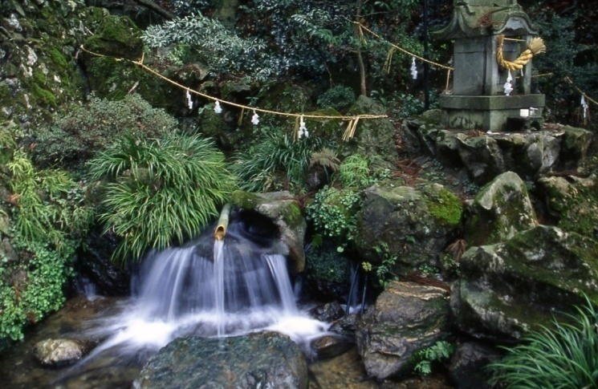
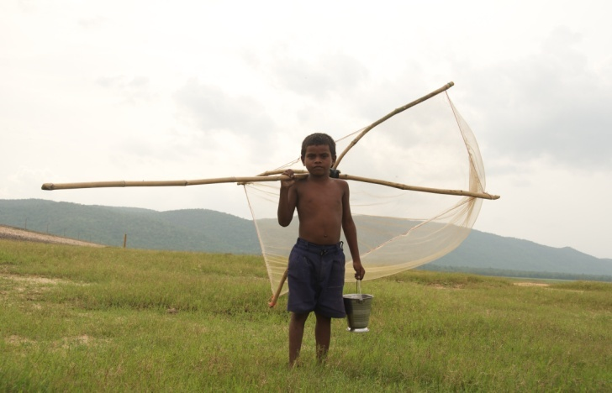
What makes the book special
Brings together various aspects ‘under one roof’
Data rich repository
Analyses issues
Includes initiatives from cross section of society
Has perspectives from global leaders
Most of all…

Slide 5
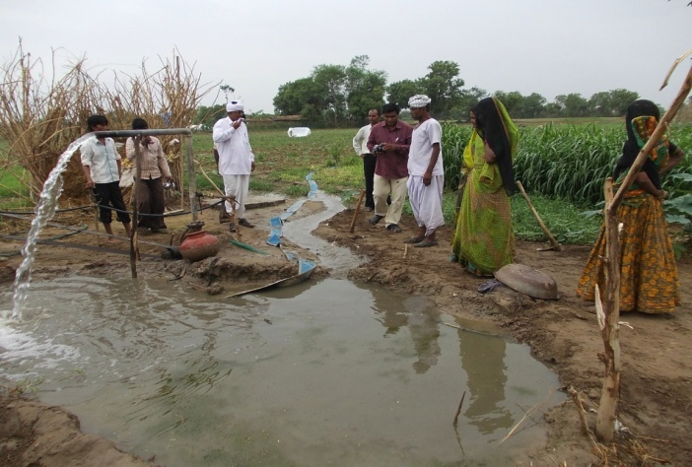
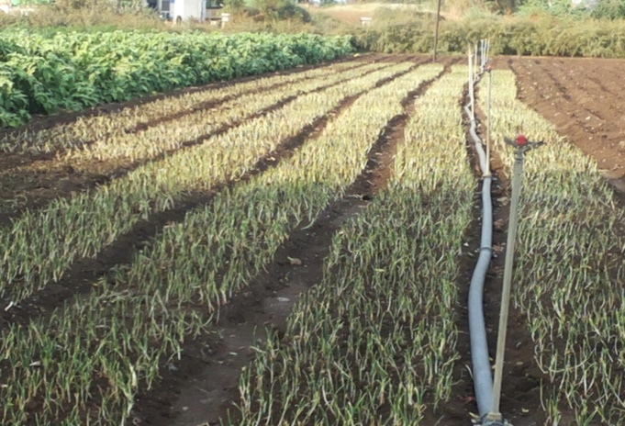
What makes the book special
Highlights the way forward, reinventing in water management
Offers lessons from global/national examples
Helps chart a course
From abandonment…
Towards water abundance

Slide 6
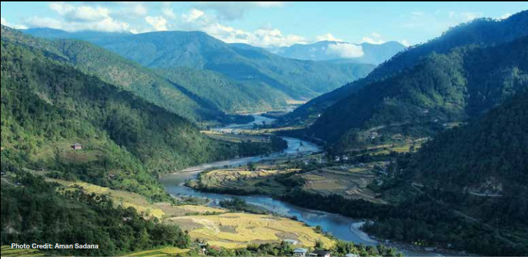
WAR: The World’s Aqua Resources
Around 1.2 billion people live in areas of scarcity
Implications for world peace, stability
Are we doing enough?

Slide 7
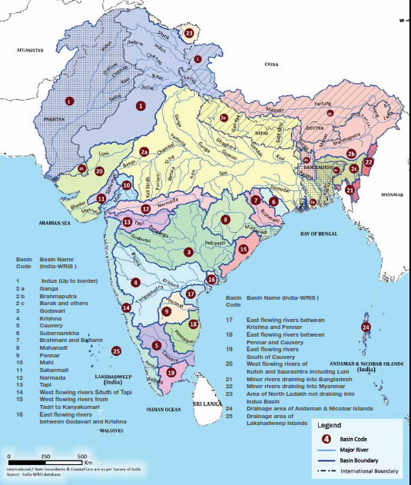
India: The water can
More than 225 rivers, groundwater, 7,500 km long coastline, lakes, ponds and springs
Why then the movement towards water scarcity by 2025?

Slide 8
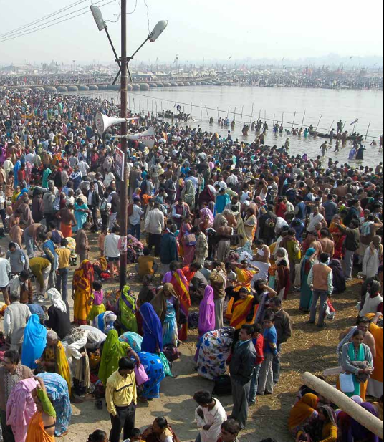
Revering and celebrating water
Integral part of religion, culture and festivals, in the fine arts and cinema
Can this be the basis of rekindling relationships between humans and water?

Slide 9
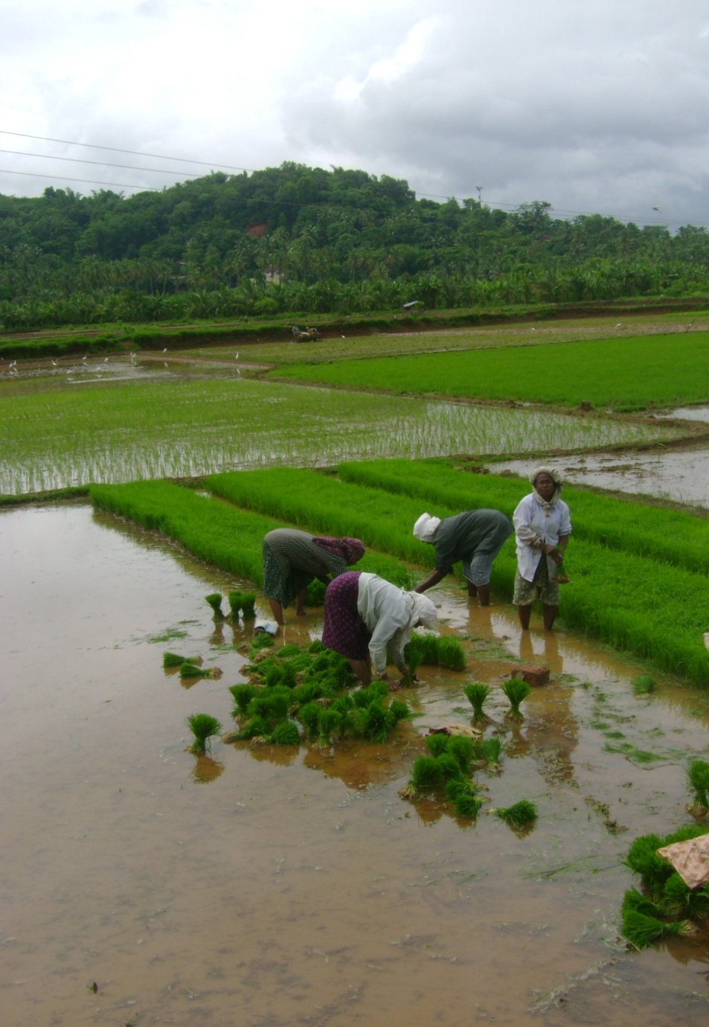
Water at work
Water is
- A human right
- Drives growth
- A 50 per cent gap between demand and supply by 2050
Is efficiency in use possible?

Slide 10
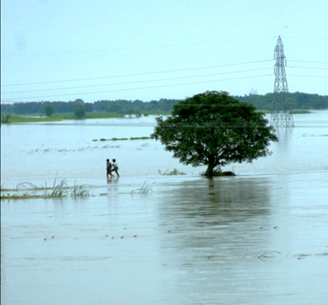
Wrath yatra: Fury of floods
Floods affect over 3 million Indians annually, some of it avoidable
Why has flooding increased and is living with floods possible?

Slide 11
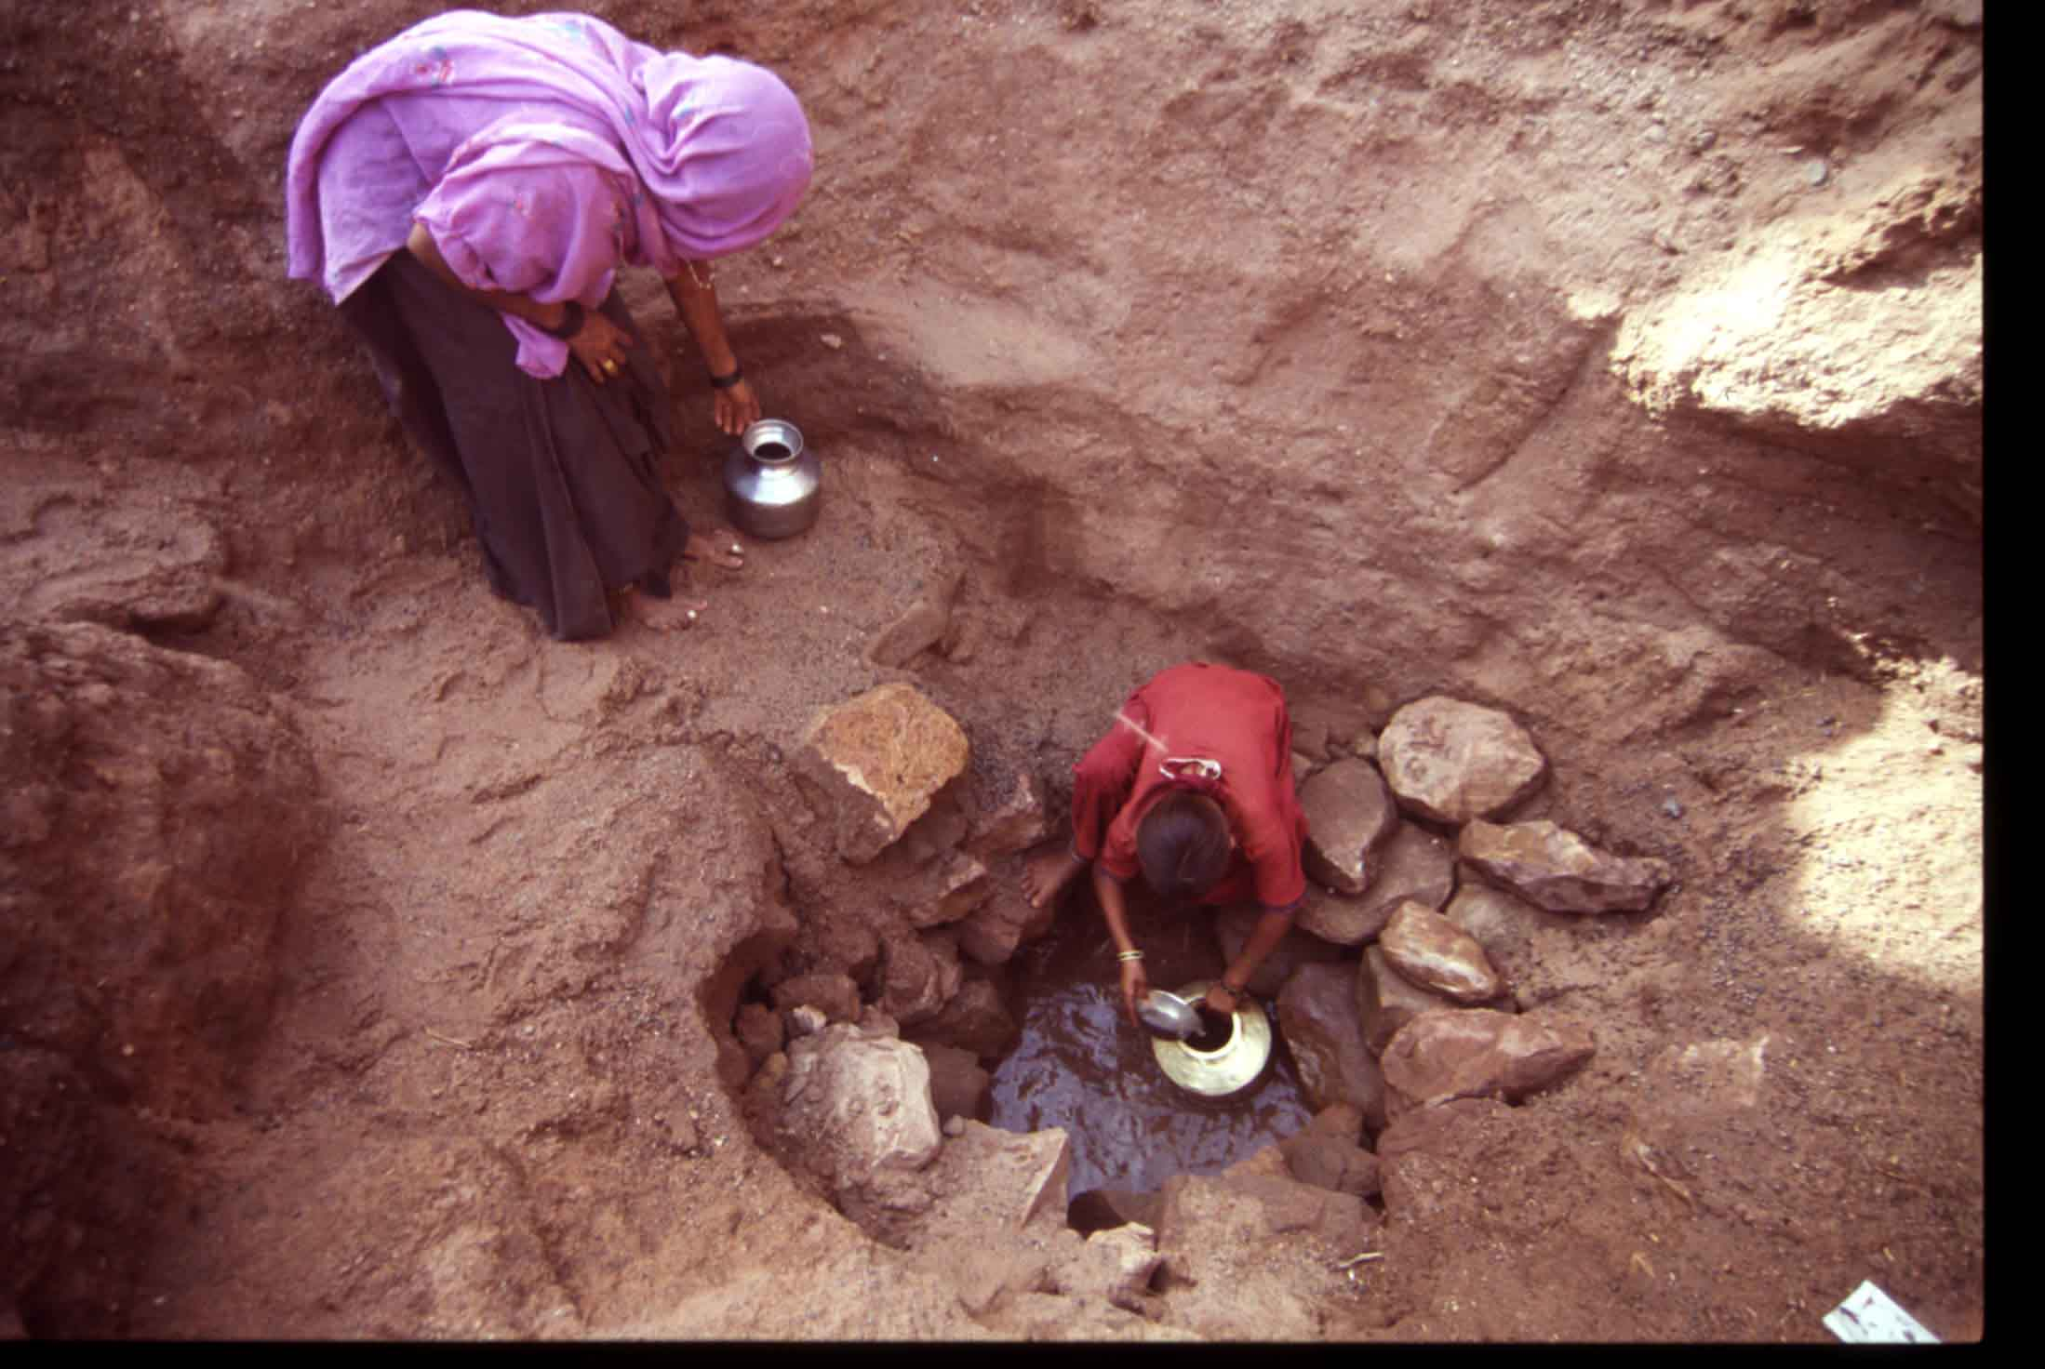
The spectre of drought
Between 1900-2006, nearly 1,061 million people were affected and 4.25 million lost their lives
Can we be better prepared?

Slide 12
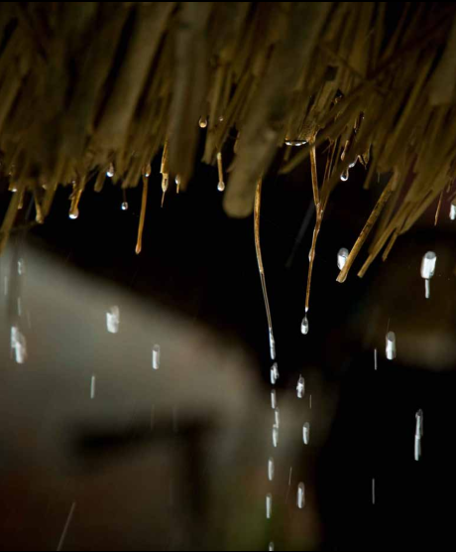
Rain: Harnessing the obvious
India is twice blessed:
With rainfall and a tradition of harvesting
How can rainwater harvesting be revived and up-scaled?

Slide 13
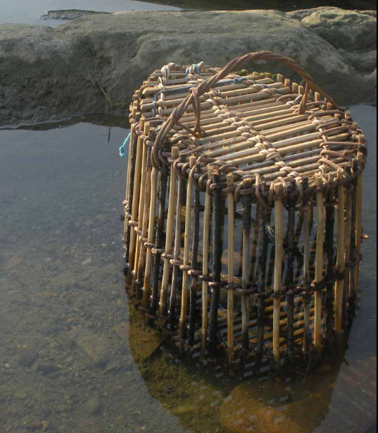
Linking life: Water and nature
India is a mega-centre of biodiversity
Water and biodiversity are interdependent
How can the two better benefit each other?

Slide 14
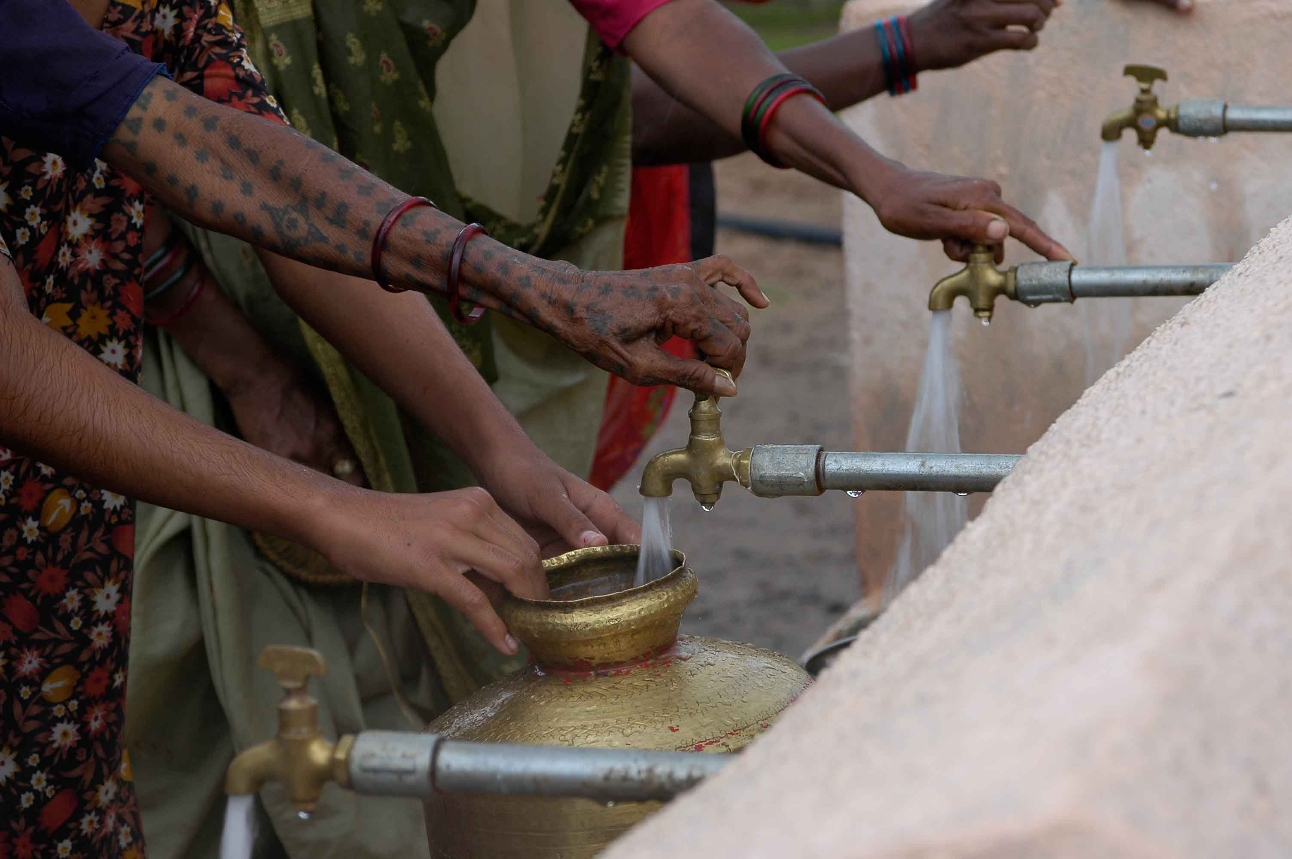
Legal landscape of water
The Indian Constitution recognises right to life,
BUT
Do we need a separate right to water?

Slide 15
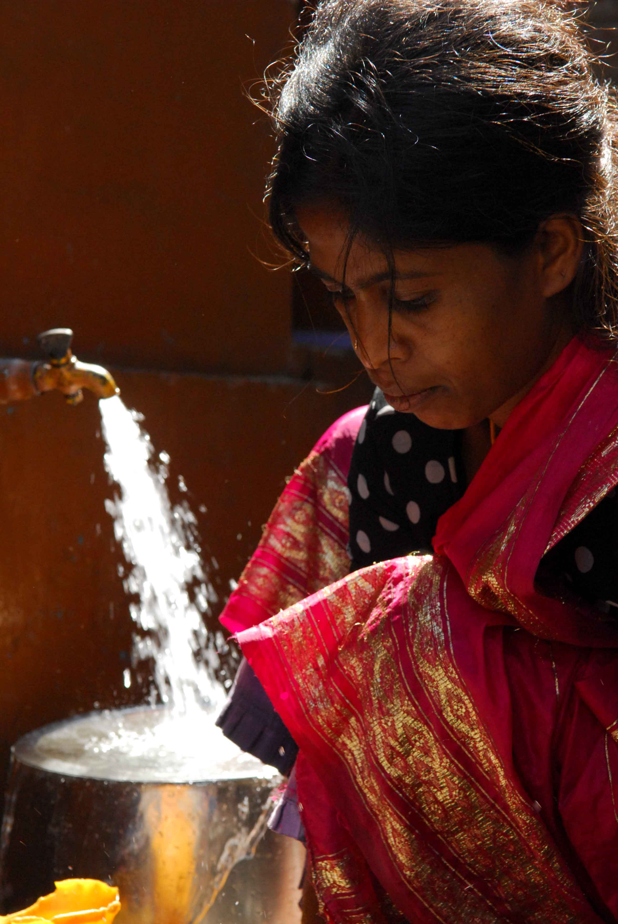
Towards abundance
Can we assure water security?
YES.
The question really is: Are we ready and willing?

Slide 16
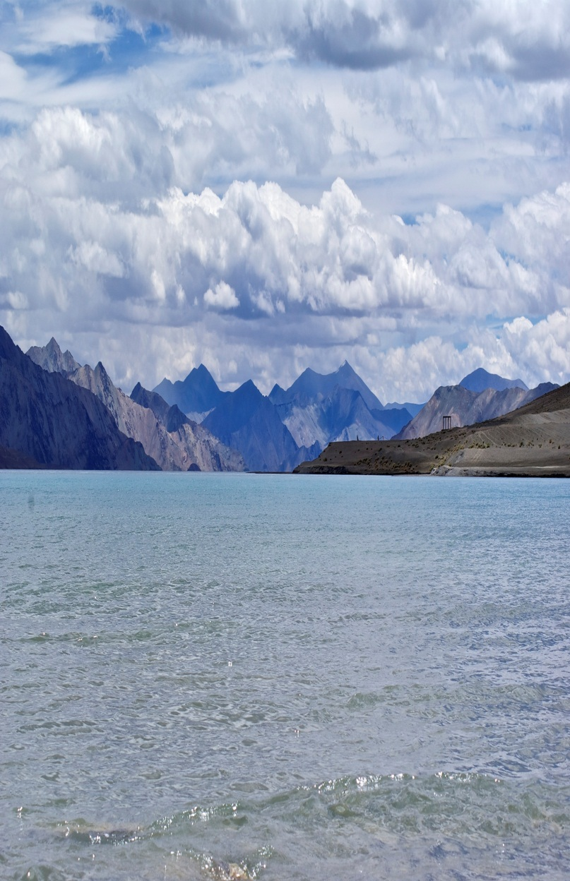
Reversing the trend
Celebrate water
Uphold principles of equity, rights and sustainability
Involve people
Achieve technology breakthroughs
Harvest rain, scale up artificial recharge
Bring efficiency in use
Water-responsible industry
Stretch water through reuse
Nurture innovation
Review and redraw

Slide 17
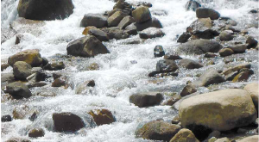
Reflections on Managing Water
Earth’s Greatest Natural Resource
Concept, Thought Leadership
Balipara Foundation
Authors
Indira Khurana, Romit Sen, Shilpi Jain
Editors
Ranjit Barthakur and Indira Khurana

