Slide 1
FOOD FOR ALL – ECOLOGICAL PERSPECTIVE
Ecological Constrains and Opportunities
C. K. Varshney
Professor Emeritus
School of Environmental Science
Jawaharlal Nehru University

Slide 2
Nature of Agro-ecosystems Systems
Agro-ecosystems are human subsidised solar powered ecosystems.
These are highly modified single species (monoculture) communities having least resilience.
Survival of agro-ecosystems depends on inputs of auxiliary energy and
materials from outside.
They are highly vulnerable and exert enormous impact on the output environment.
Agriculture is one of the most climate – dependent activities.

Slide 3
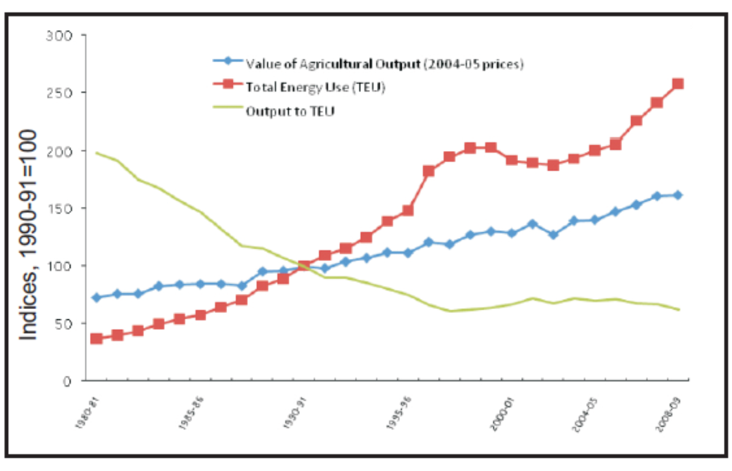
Trends in Energy Use and Value of Agricultural Output
Indices 1990-91 =100
Source: Jha et al, IARI, 2012

Slide 4
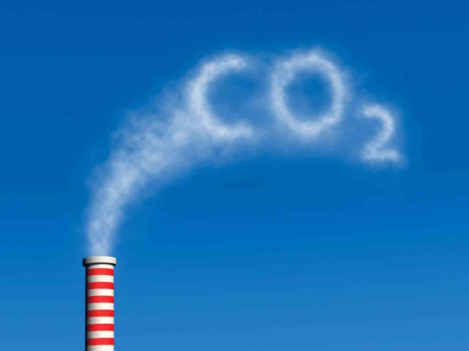
CO₂ Emission
Agriculture sector is highly vulnerable to climate change, agricultural production is a major contributor to the problem, accounting for 17.6 percent of gross emissions in India. This figure increases to 27 percent by adding emissions related to consumption.
Agriculture as an economic activity is not only less productive but also highly carbon intensive – hardly aliened to the much desired sustainable scenario.

Slide 5
Renewable Energy - Wind and Solar
(A fast-changing cost profile)
The key reason that renewable energy can now play a major role is that costs have fallen very fast. In 1990, wind power was 3–4 times more expensive than fossil fuel electricity, making it infeasible at scale. Since then costs have dropped by half or more while performance has increased dramatically.
Solar PV power remains costlier, but is now half the cost it was just in 2010, as module prices have fallen 80% since 2008 and likely to fall further.

Slide 6
Fertilizers
Fertilizer import by India was about 2 million tonnes in early part of 2000, increased to 10.2 million tonnes in 2008-09. India was the third largest producer of fertilizers in the world next to China and USA and the second largest consumer after China during 2008.
The overall consumption of fertilizers in the country has increased from 65.6 thousand tonnes in 1951-52 to 26.49 million tonnes in 2009- 10.
By 2020, fertilizer demand in the country is projected to increase to about 41.6 million tonnes – 23 million tonnes of N, 11.5 million tonnes of P and 7.1 million tonnes of K.
Accordingly, per hectare consumption of fertilizers, which was less than one kg in1951-52, has gone up to the level of 135 kg in 2009-10.
Source: Jaga & Patel.IJSET. 2012.

Slide 7
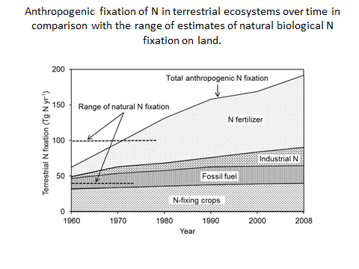

Slide 8
Soil Erosion
India losing 5,334 million tonnes of soil annually due to erosion: (Govt.)
Negative nutrient balances in most Indian soils not only mirror poor soil health, they also represent severe on-going depletion of the soil’s nutrient capital, degradation of the environment, and vulnerability of the crop production system in terms of its ability to sustain high yields.
No amount of planning for higher agricultural production targets will bear fruit on impoverished, nutrient depleted soils whose nutrient balance sheets have been in the red for decades. Depleted soils will refuse to deliver the goods if not handled properly.
The custodian of national wealth and well being is as much the soil bank of India as is the Reserve Bank of India. BC

Slide 9
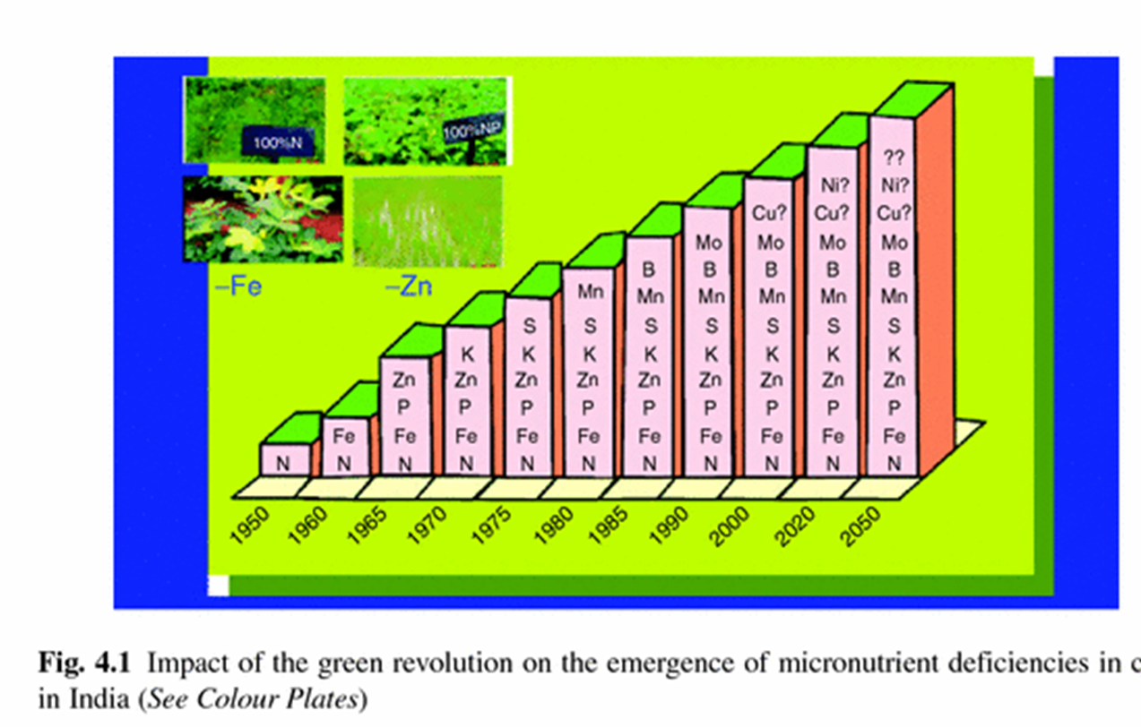
Increasing Micronutrient Deficiency

Slide 10
Pesticide Substitute – “Push-pull Technology” for pest control
It is based on a novel cropping system developed by the International Centre of Insect Physiology and Ecology, Rothamsted Research (UK) and national partners for integrated pest, weed and soil management in cereal—livestock farming systems.
It entails mixing, into a field of crops, plants that repel insect pests (‘push’) and planting, around a crop, diversionary trap plants that attract the pests (‘pull’).
Stem borers are attracted to Napier grass (Pennisetum purpureum), a trap plant (pull), and are repelled from the main cereal crop using a repellent legume intercrop (push), desmodium (Desmodium spp.).

Slide 11
AIR Pollution an Important Factor Affecting Crop Yield
_{Ground level ozone pollution}
Chemically Identical to Upper Stratospheric Ozone
Ground level ozone is formed from as result of physio-
chemical reaction. Between volatile hydrocarbons (VOCs)
and Oxides of Nitrogen (NOx) emitted from human activities.
VOCs+ NOx + Heat + Sunlight = Ozone

Slide 12
Ground Level Ozone
Ground level ozone (O3) is the most widespread and phyto-toxic pollutant that frequently exceeds WHO air quality guidelines for agricultural crops across many parts of the globe.
Elevated O3 levels have been found to cause declines in the yield of many crop species, such as wheat, rice, soybean , potato, soynean and many vegetable crops.
Surface O3 concentrations have been modelled using MATCH (Engardt, 2008), an atmospheric pollution dispersion model used extensively within Malé Declaration activities.
Modelling studies have identified that the spring and summer months have the highest O3 concentrations these periods also coincide with the peak growing seasons of many important south Asian crops.

Slide 13
New Crop Breeding Strategy
Crop breeding programmes to reduce sensitivity in crop varieties. If the sensitivities of different cultivars were known, the use of resistant cultivars could provide an important adaptation option against O3 impacts.
Experimental data has shown that variability in the sensitivity to O3 of different crop varieties can vary by as much as 50%.
Current evidence suggests that more recently bred crop varieties have a greater sensitivity to O3 it will be important to ensure that breeding programmes are not inadvertently introducing traits that increase crop vulnerability to O3.

Slide 14
Wetlands
ISRO has mapped a total of 201503 wetlands at 1:50,000 scale in the country. In addition, 555557 wetlands (< 2.25 ha) have also been identified.
Total wetland area estimated is 15.26 Mha, which is around 4.63 per cent of the geographic area of the country.
Excluding rivers, wetlands cover some 10 million hectares, or a little over 3% of the country’s geographical area.

Slide 15
Enhancing Efficiency of Photosynthesis
The results published in Nature, surmount a daunting hurdle on the path to boosting plant yields — a goal that is taking on increasing importance as the world’s population grows.
Researchers have long wanted to increase yields by targeting Rubisco, the enzyme responsible for converting carbon dioxide into sugar.
Rubisco is possibly the most abundant protein on Earth, and can account for up to half of all the soluble protein found in a leaf.
But one reason for its abundance is its inefficiency: plants produce so much Rubisco in part to compensate for its slow catalysis.
Some have estimated that tinkering with Rubisco and ways to boost the concentration of carbon dioxide around it could generate up to a 60% increase in the yields of crops such as rice and wheat.

Slide 16
Agricultural Subsidy
Degrading Restorative
Fossil fuel Energy
Fertilizers
Pesticides
Heavy Irrigation input
Impacts
Reduces Biodiversity
Natural capital degraded
progressively
High emission of GHGs
Capital Intensive
Increases dependency
Limited scope for innovation
Solar Energy
Biological Nitrogen Fixation
Crop rotation/ Push-pull
Wetland conservation,
Impacts
Promote Biodiversity
Scope for extra-income
Enriches Natural capital
Progressively
Relatively low GHGs emission
Low capital Demand
Encourage Innovation

Slide 17
THANK YOU !

