Slide 1

Scaling up of SRI/SCI method of crop cultivation in Bihar
PRESERVATION AND PROLIFERATION OF RURAL RESOURCES AND NATURE (PRAN), Gaya, Bihar

Slide 2

Partnering with: small & marginal farmers
Situation of small and marginal farmers
High rates of food insecurity and no cash availability (Financial exclusion)
Hub of India’s small and marginal farmers
Low productivity of major food security crops (rice, wheat).
  Average rice yield (Gaya): 1.6t/ha (about two third of national level)
  Average Wheat yield (Gaya):2t/ha (about a third of that of Punjab)
Agriculture dominated by rain-fed production system and also vicitim of flood
Poor access to production resources: Very low Irrigation availability and lack of access to electricity; high cost of diesel
Poor and ineffective market infrastructure
Weak agriculture supply chains
Lack of Agro-processing and Post Harvest Technology
Poor and ineffective institutional support and governance (particularly of Schedule Castes and Other Backward Castes)

Slide 3
BIG Scenario:
Macro Economic scenario, which is Identical
Natural resources declining.
Rural Livelihood under threat and Rural Life at Stake.
Poor penetration of Green Revolution technology yet the existing situation confronting diminishing returns.
Thus there is urgent need for pro-poor Agro ecological Innovations.
Existing cutting-edge technology is unsustainable as it targeted the crop life above ground, and the mainstream R&D ignored the precious aspects of below ground activities (root system and microbial life).

Slide 4

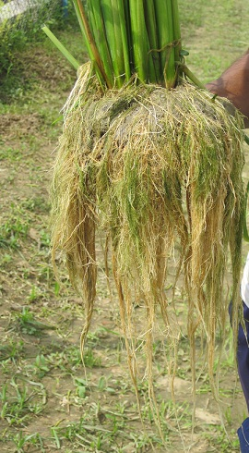
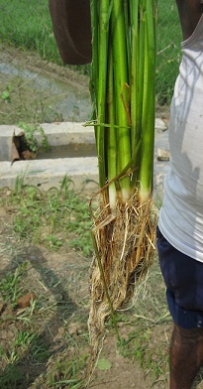
Addressing food Insecurity through appropriate Technologies:
System of Root Intensification (SRI)- as inclusive socio-economic entity
Normal
Root is the mouth of the plant –
keep that healthy
SRI
SRI method consider root play crucial role (different from green revolution in the country). In addition, SRI uses
Enhanced root volume and length of SRI compared to normal method
Low external inputs (seed, fertilizers, water, labor) to make this within reach of resource poor families. THIS LEADS cost-effective CROP ECONOMY
HOUSEHOLD FOOD SECURITY: High productivity to ensure enhanced availability of home-grown food grains to small and marginal farmers
SRI is an inclusive system and ensure Sustainability (Conserving precious soil, water and environment carrying capacity for future generations)

Slide 5
Understanding basic principles of SRI
Priming of seeds & planting material
Young age seedlings/sprouted seeds
Wider spacing
Single/Few/ seedlings/seeds
Use of Integrated Nutrient Management/organic/natural fertilizers
No standing water in field; keep soil moist
Interculture with weeders to aerate soil and improve root health
Surface sowing/transplanting
Providing space(pit) for roots to grow to maximum potential
Nutritional and microbial security to rhizosphere
Organic relationship of human with trees and plants
Emotional relationship of practiceners and farmers with the growth stages of crops

Slide 6
WE DWELT ON:
Transfer of Innovation to improve its spread among the poor
Because:
Innovation is more knowledge intensive and less of input intensive
Knowledge has to be delivered to bypassed people who matters
Proper institutional architecture is required to be developed
Informal institutions can lead knowledge extension, but formal agencies needs to provide strength and actionable policy framework for wider out reach

Slide 7
OUR Strategies: strengthening
Awareness generating among the deprived communities
Use of audio-visual (SRI film) and flex extension materials/manuals as easy understandable tool
Using old experienced SRI farmers to Campaign in villages
Regular Village meetings for awareness, motivation and adoption in continuum
Collaborating with Government Extension and Research Programs ( ATMA, KVK, Research Institutions, etc)
Stakeholders workshops: Block, district, State, Agricultural universities and others
Participating in Kisan Melas and SRI Jhanki
Approaches: Never before approach to use local human resource for local production technology
Pro-poor Incentives to VRPs (Building on strengths in stakeholders)
Pro-women incentives to staff and VRPs
Facilitating women Common Interest Groups/Village organisations /Self Help Groups
Credit is to be given and not to be taken
Collective ownership of successes and failures
Non-Negotiable - Maintaining Integrity at all levels
75% : 25% EMPHASIS TO motivational AND technical
Panch S (Satya, Samay, Seva, Sanskar and Samanta) and Panch J (Jal, Jungle, Jameen, Janwar and Jan) (Principles of development in practice )

Slide 8
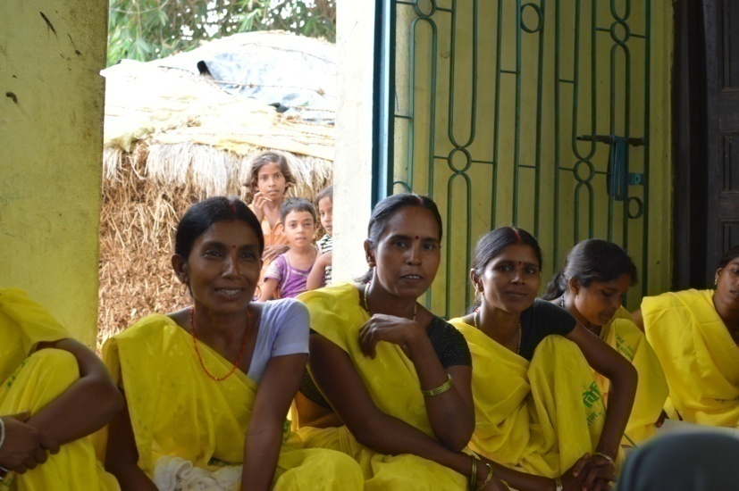
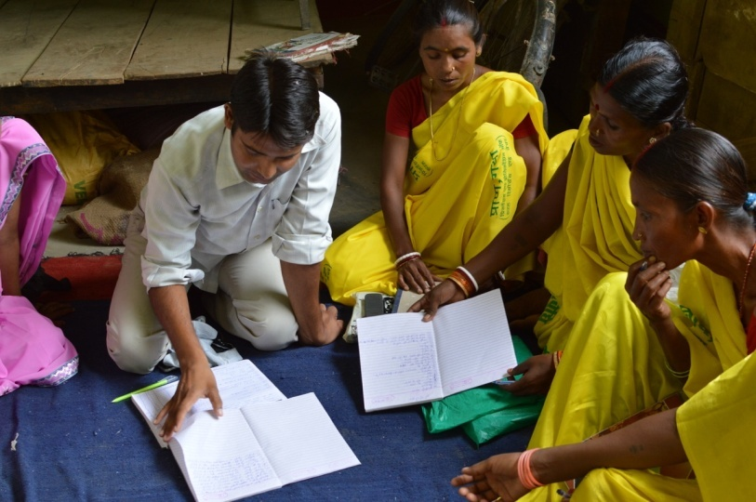
Innovative Governance structure
Capacity Building for Rural Development
Village Resource Persons (A critical and basic requirement )
The best practiceners identified by
Villagers/women CIGs/VO for training in 3-4 phases including:
Motivational and Capacity Building Training
Technical Skills development
Learning by doing
Repeated Engagement and long-term partnerships

Slide 9
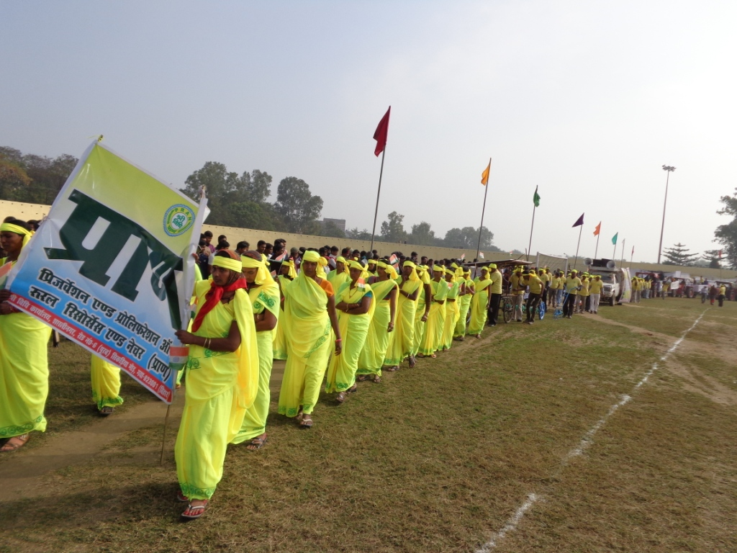
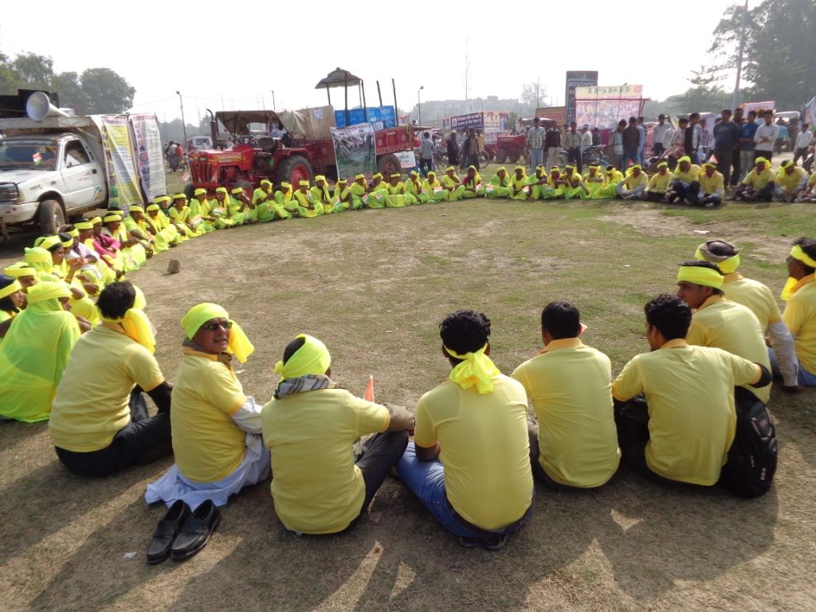
SRI Awareness & GOVERNANCE:
PRAN Farmers Highlight “SRI Vidhi” in Gandhi Maidan, Gaya on Republic Day every year
Village Resource Persons (VRPs) and s&m farmers participating in Jhanki. wearing yellow sari indicting color of SRI Vidhi.

Slide 10
Quantitative IMPACT:
Pre and Post project in pilot villages..1
S.No | Pre deployment of SRI method of crop cultivation | Post deployment of SRI method of crop cultivation
1 | Most of the families, food production in their own farm was sufficient for only for 3-6 months | Most of the families getting food grain security round the year
2 | Earlier dependent on mahajans for credit in hours of need. | Those who are practicing SRI method of crop cultivation in cereals, vegetables are getting cash income apart from food grain security
3 | The indiscriminate use of pesticides and chemical fertilizers. | Reduced the use of chemical fertilizers and pesticides substituted by organic/natural.
4 | PEOPLE: Usually poor farmers particularly MAHA-DALIT were forced to migrate in search of food | Substantially Reduced forced migration in remote villages.
5 | SEED: Farmers used 40kg of Paddy seeds per acre, 54-81Kg of wheat seeds per acre and 7-8 kg of oilseeds per acre | Now they are using 2kg of Paddy seeds per acre, 10 kg of wheat seeds per acre and 250gm-1 kg of oilseeds per acre.
6 | FOOD: The Mahadalit commonly took only alternate meals to survive and often skip the meals. | SRI increased production and provide balanced and sufficient diet daily.

Slide 11
Pre and Post project in pilot villages……2
S.No | Pre deployment of SRI method of crop cultivation | Post deplyoment of SRI method of crop cultivation
7 | DEPEDENCE: Farmers were highly dependant on markets for fertilizers and pesticides | In many villages farmers are themselves preparing vermicompost,local fertilizers and pesticides.
8 | GENDER IMPACT: The women in villages were reluctant in speaking to outsiders | Women now come out in the fore front to demonstrate their internal confidence and capability.
9 | QUALITY GRAIN: Often satisfied with poor quality grains and vegetables to eat | The farmers and families are getting quality grains and vegetables to eat
10 | MAINSTREAMING SRI: Scientific institutions were hesitant to accept SRI | ICAR institutions and Agricultural scientists have started appreciating SRI
11 | IMPACT ON STATE PRODUCTION: Production of rice was less than 4 million tones in a year | Today, Bihar proudly produce more than 8 mt of Paddy, which won Krishi Karman award from President of India deploying new method

Slide 12
Some Macro Impact of SRI
(assuming 26 mh Irrigated rice in the country)
 | Conventional Method of cultivation | SRI | Savings |  | Remark
GAIN DUE TO INPUT SAVING
Seed - million ton (@5 vs 50kg/ha) | 1.30 mt | 0.13mt | Rs.3510 crores
Water | 5960 mcm | 3680 mcm | 2280 mcm |  | Irrigation to 1.02 mh additional area
Production comparison | 19.68 mt | 25.68 mt | Gain of 6 mt, @ value Rs.6000 crores
INCREASED IN production
Potential states (irrigated rice) | Andhra Pradesh ,Tamilnadu, Karnataka MP, Uttar Pradesh Bihar, West Bengal, Tripura, Jharkhand, Punjab, Sikkim
Enhanced Food Security IMPACT
Yield (irrigated rice) | 4803 kg/ha | 6318 kg/ha |  | 1505 kg difference (32% more)
House food security (Availability of additional Rice in 25 cent (1/4acre) landholding at farmer field), | 76 days | 228 days |  | additional food for 152 days
 | 0.25 acre land
 | Production of rice | 2 quintal food (rice) consumed in 2.5 months 6 quintal food for 8 months Ref: NABARD Jharkhand case study 2012

Slide 13
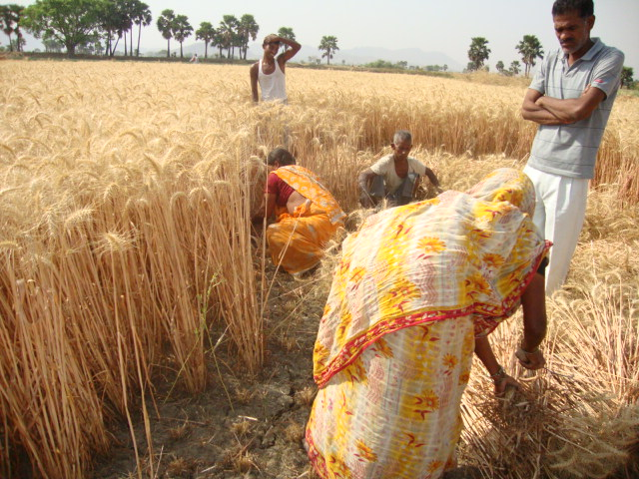
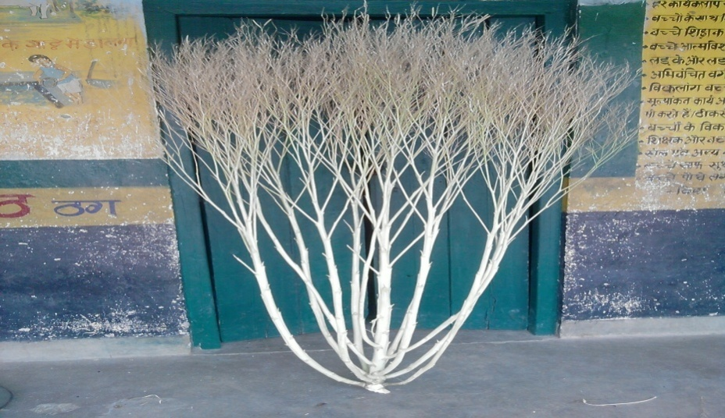
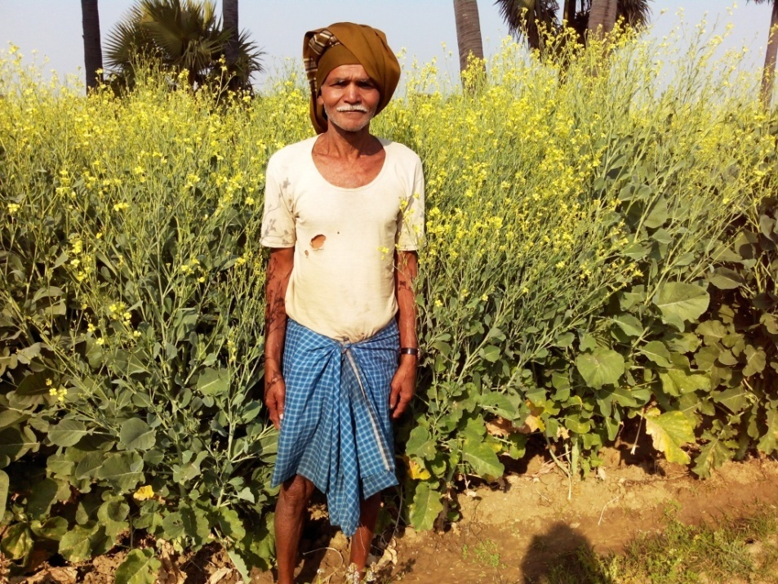
ON-FARM Impact (voice of farmers) of SRI on food-grains and oilseeds
Achieving Food Security: Marginal and poor families adopting SRI in Paddy and wheat are getting secured food-grains.
Earning Cash Income for Improved Livelihood Security: The family adopting SRI in Paddy, Wheat and oilseed ,Vegetables are getting surplus cash.

Slide 14

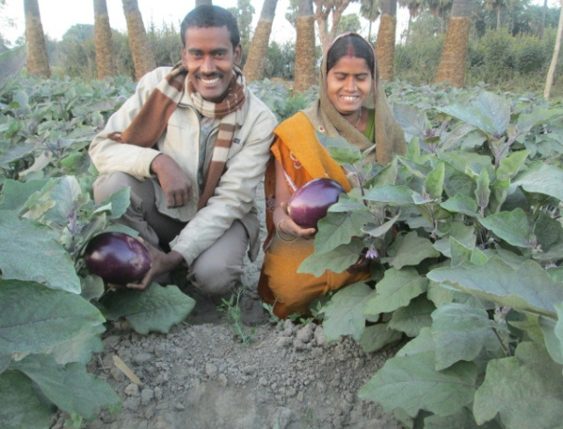
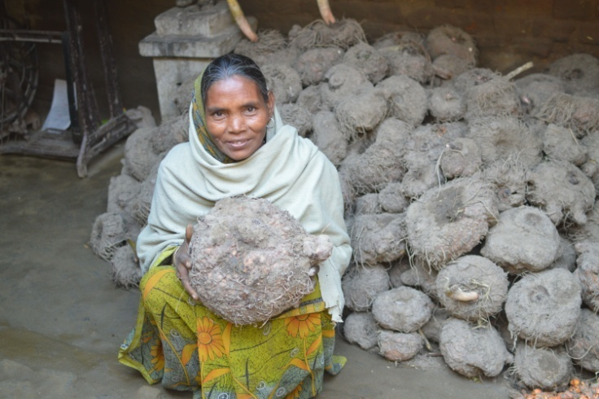
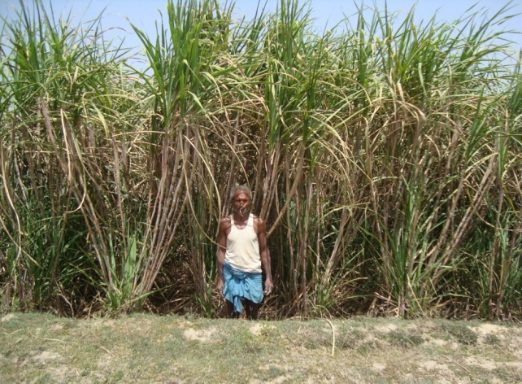
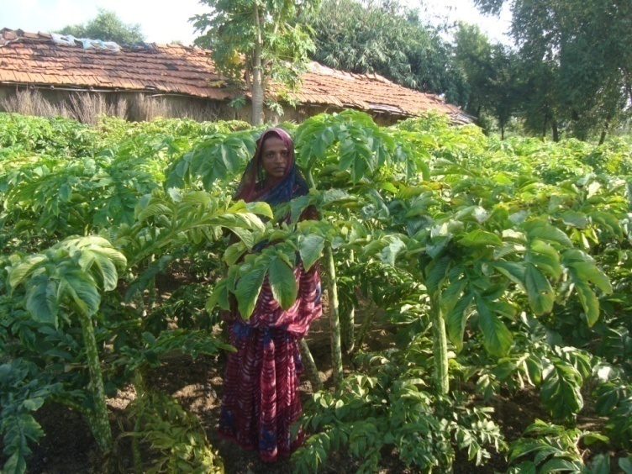
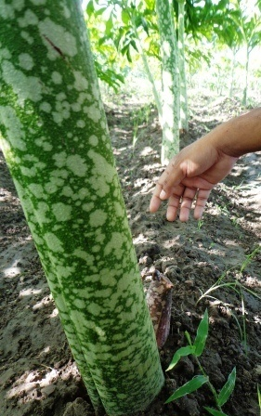
SPILL OVER: SUCCESS STORY ON NEGLECTED CROPS:
WHEAT
other coarse cereals
OILSEEDS
Vegetable and Pulses
SUGARCANE
SRI-Brinjal
High growth of shoot and girth
High Yield
SRI Sugarcane

Slide 15
PERCEPTION::: FARMER CERTIFIED:
SRI Paddy enhanced production by 100%
SRI Wheat enhanced production by 50%
SRI Green gram enhancement by 50%
SRI- Tomato-Yield enhancement by 55%
SRI-Chilli-Yield enhancement by 22%
SRI-Brinjal-Yield enhancement by 45%
SRI-EFY-Yield enhancement by 80%
SRI-Sugarcane-Yield enhancement by 85%
SRI-Rapeseed-Yield enhancement by 150%
PRAN has successfully piloted SRI in the Above crops-Yield enhancement certified by small and Marginal Farmers in Villages

Slide 16
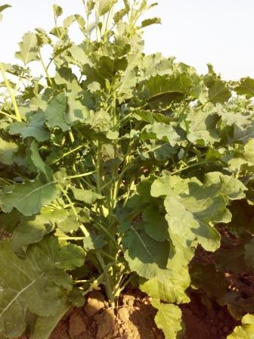
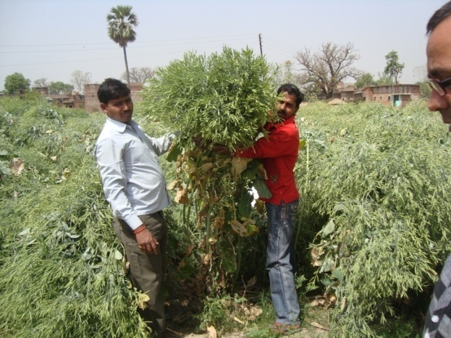
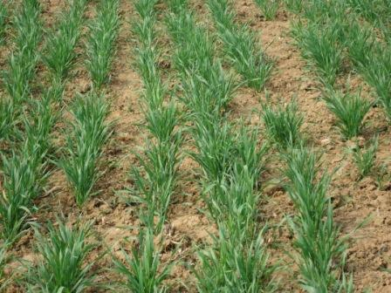
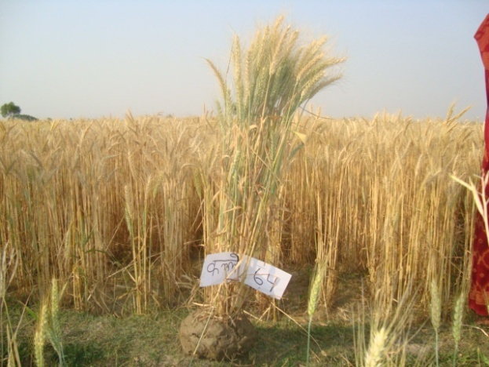
Examples of Success CONTINUED ……
Young SRI Rapeseed
Harvesting SRI Rapeseed
Young SRI Wheat Plant
64 panicles from 2 seeds of wheat
A VRP looking at SRI Tomato

Slide 17
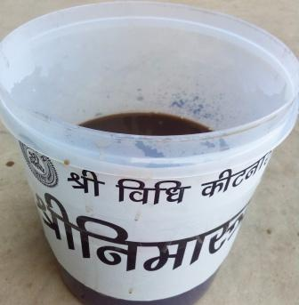
OUR PREPAREDNESS: INNOVATING ITK
Technologies IMPROVISED and practiced at PRAN
PRAN works in conjunction with partners (local black-smiths, and company) to develop technologies appropriate for marginal farmers
SRI-implements: 3 –in-1 SRI dry weeder
Work on generations of SRI-Wheat seed drill
Tool for easy spacing used in SRI transplantation
Fertilizer (made by us and practiced by farmers): Sripranamrit and Sribakaramrit
Bio-pesticide (made by farmers ) we learnt this from Subhash Palekar
Locally manufactured sugarcane eye extractor after procuring from N.Delhi

Slide 18
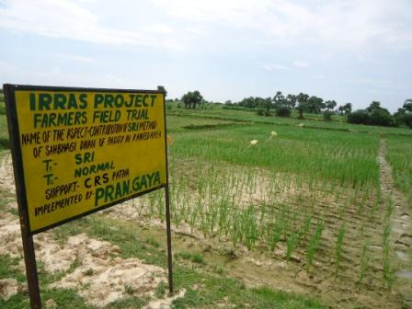
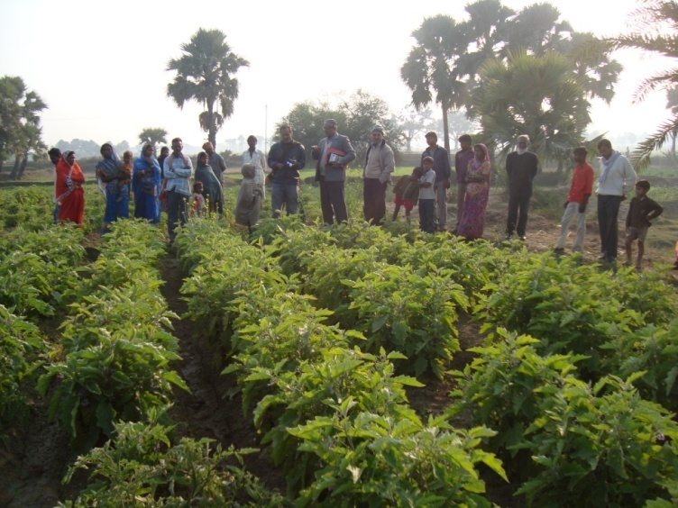
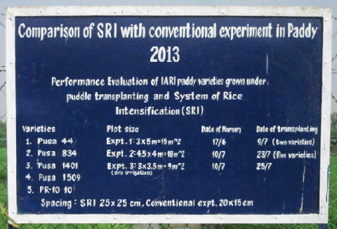
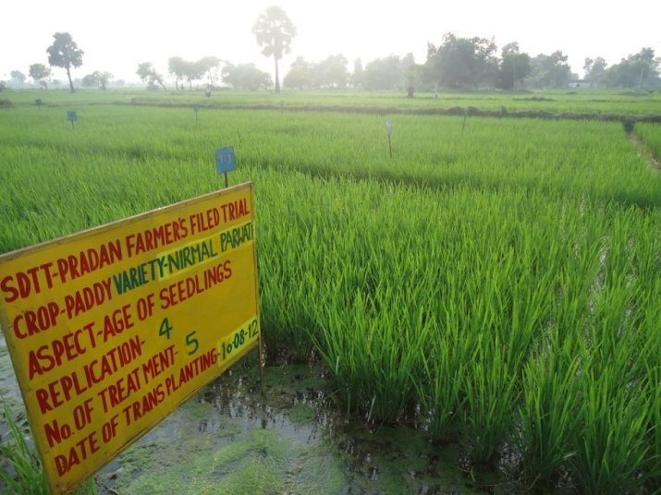
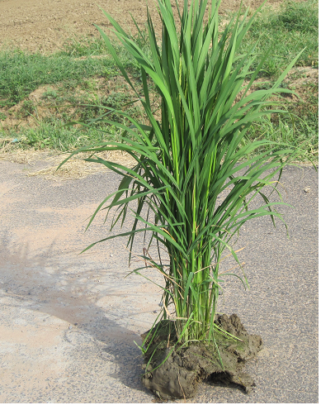
SRI COLLABORATIONS:
PRAN undertaking Researches on SRI
A farmer from Gaya has been helping scientists at Indian Agriculture Research Institute, New Delhi (IARI) to experiment SRI-Paddy and Wheat since 3 years .
Indian Council of Agricultural Research, Patna (ICAR) is also getting good results in wheat and Paddy
Wheat Research Institute, Karnal (WRI), and Directorate of Rapeseed-Mustard, Bharatpur asked for Package of Practices of SRI-crops
Various Civil societies associated with NCS (National Consortium of SRI)/SRI secretariat)
IRRAS Research Field in Mohanpur block,Gaya
IIRD,Hyderabad scientist in SRI-Brinjal plot with district officials
Research projects with Livolink Foundation

Slide 19
ADAPTATION OF INCLUSION PROCESS over the years:
Adoption of SRI-Paddy with PRAN
Year | 2009-10 (Drought Year) | 2010-11 (Drought Year) | 2011-12 Irregular rainfall | 2012-13 Rainfall in August | 2013-14 Drought Year
Families | 5,994 | 5,217 | 18,764 | 26,142 | 10,249 (vs15,000 plan)
Growth in No. of Families over Pervious Year | N/A | -12.96% | 259.67% | 39.32% | - 60.79%
Acres | 761 | 650 | 3,140.49 | 6,921.4 | 3349
Acres per Family | 0.13 | 0.12 | 0.17 | 0.26 | 0.33 (vs0.30 planned)
Average Yield | 7 t/ha | 6 t/ha | 6 t/ha | 6.5 t/ha | 5.97 t/ha

Slide 20
Yields of SRI/SCI-Vegetables(12-13)

Slide 21
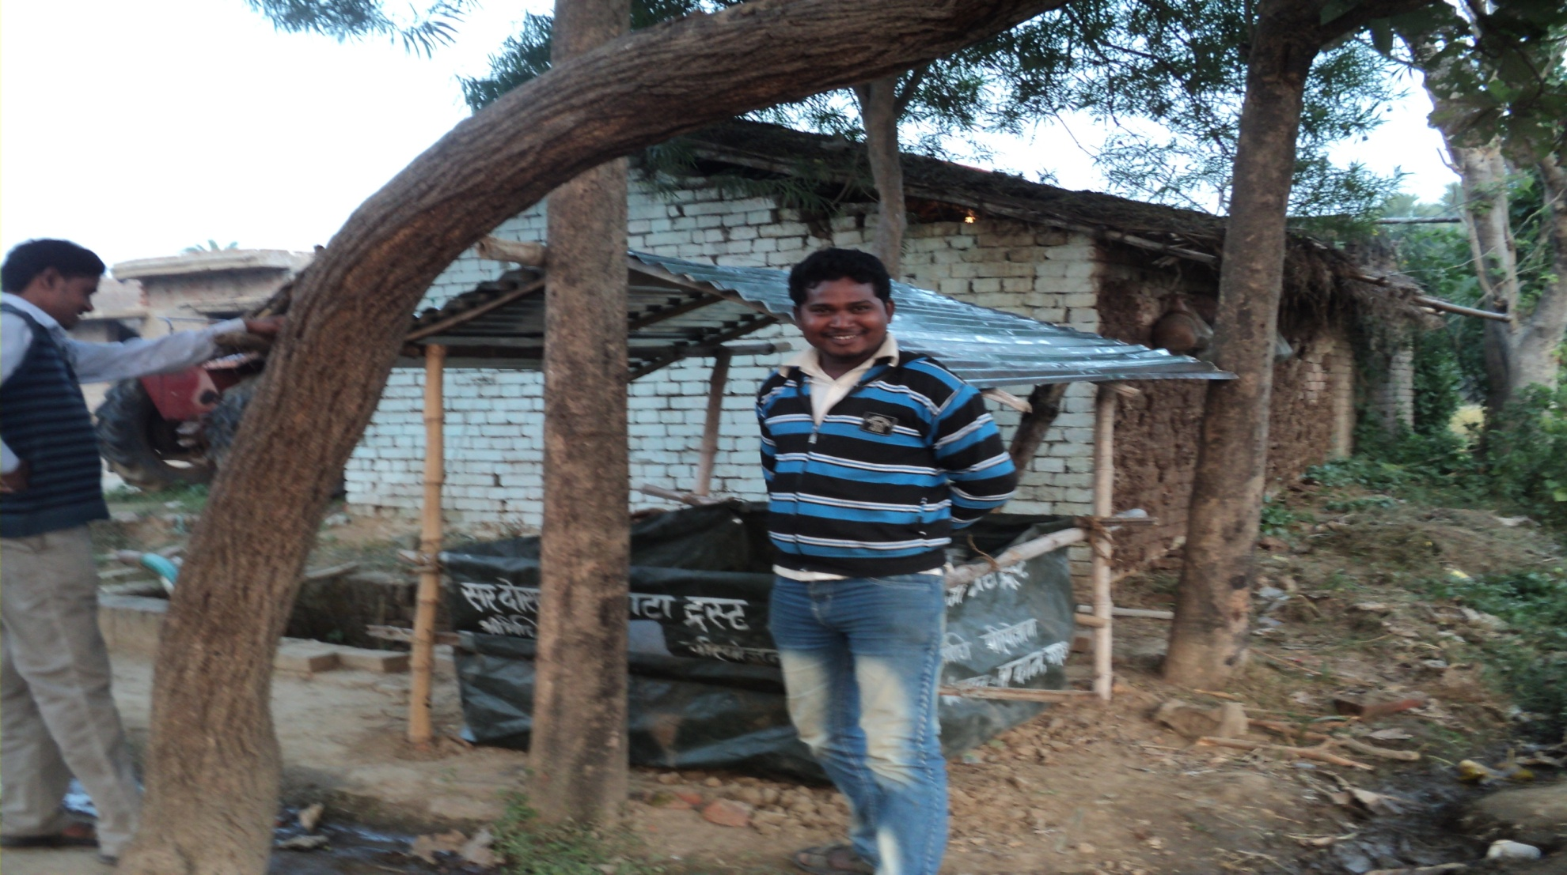
Low cost vermi-compost(SDTT/ATMA)

Slide 22
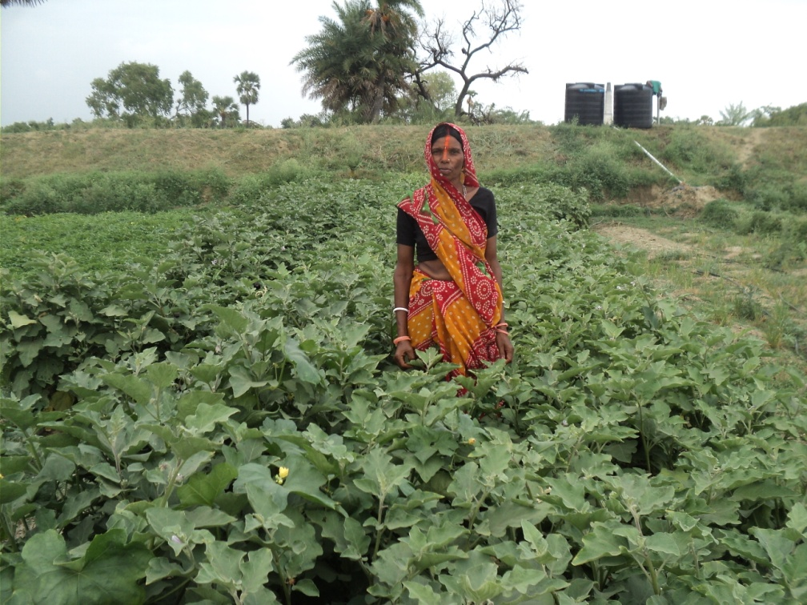
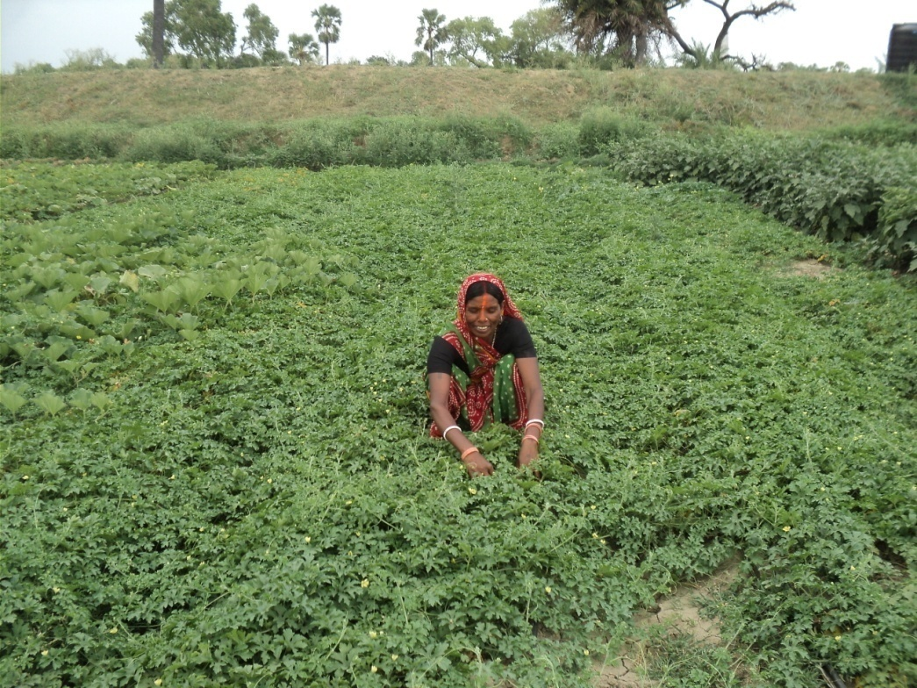
SRI-Vegetables with Mahadalit communities using drip irrigation

Slide 23
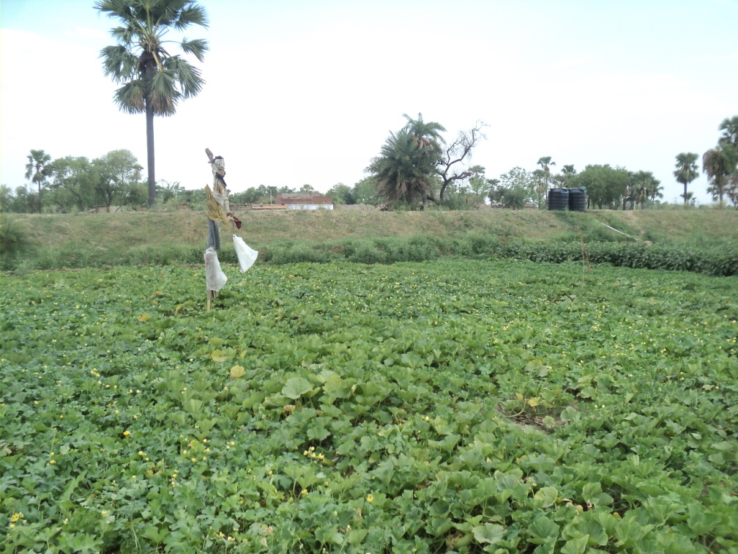
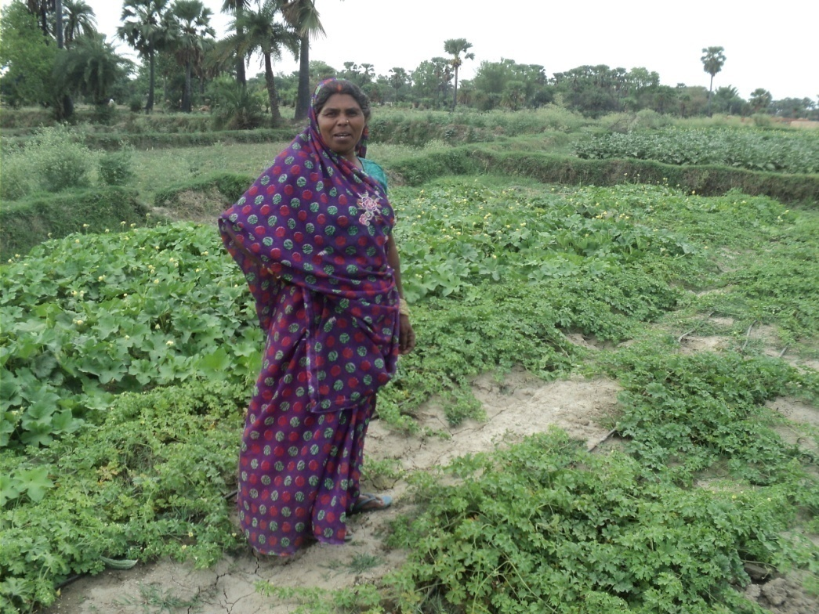
Poorest communities getting confidence with dignified livelihoods

Slide 24
Previous Rabi crops
SRI CROP | NO. OF FAMILIES IN 2012-13 | AREA IN ACRE IN 2012-13 | Acreage/farmer in 2012-13 | NO. OF FAMILIES IN 2013-14 | AREA IN ACRE IN 2013-14 | Acreage/farmer in 2013-14
SRI-Wheat | 7,368 | 782.98 | 0.11 | 5268 | 709.80 | 0.13
SRI-Rapeseed | 3,205 | 336.21 | 0.10 | 1559 | 172.53 | 0.11
SRI-Vegetables | 586 | 35 | 0.06 | 2212 | 137.45 | 0.06
SRI Other Crops Acreage 0.10 vs planned 0.15 per family

Slide 25
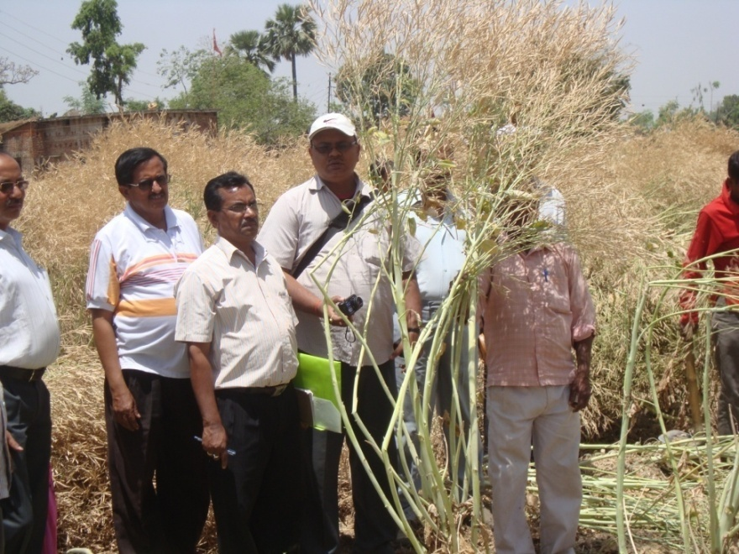
REWARD & INCENTIVE:
National Award for farmers
SRI farmers got award from Honorable President of India
Santosh Kumar got award from Sri Sharad Pawar ,Minister of Agriculture, GOI (July2013)
Jayjeet Kumar got award and a cash prize of Rs 50000/- from Sri Narendra Modi.(Sept 2013)
PRAN got skotch award for promoting SRI/SCI method among farmers in 2014.
PD, Deputy PD ATMA, District consultant, Department of Agriculture and block level officials involved in yield estimation

Slide 26
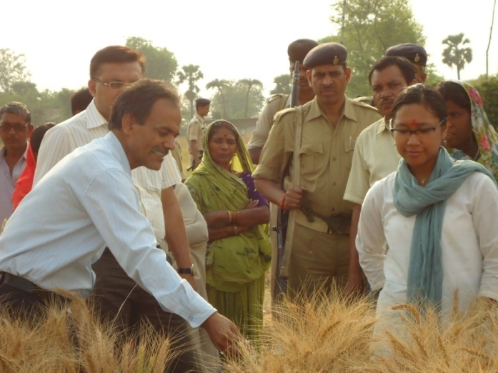
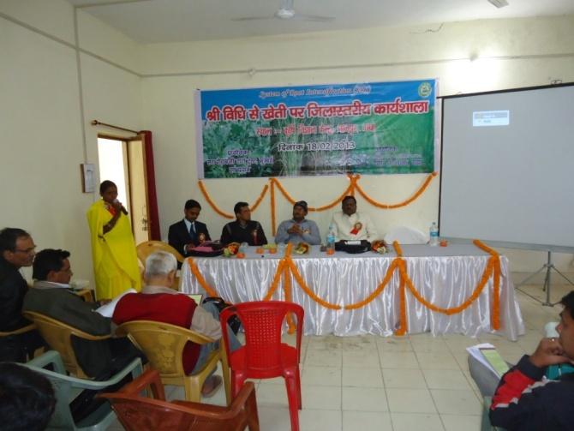
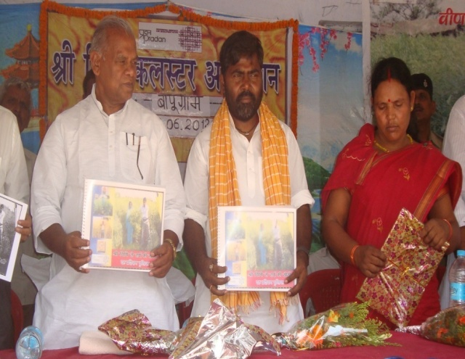
Institutional recognition:
PRAN Collaboration with Government
Bihar Rural Livelihood Promotion Society (BLRPS) in all project districts
Declared 2011 as SRI year
Demonstration of SRI-Paddy in 3.5 lakh hectare and SRI-wheat in 2.4 lakh hectare
Bihar awarded Krishi Karman Award for highest ever production of Paddy by the Honorable President of India
Government deployed Women farmers in the forefront to share their experiences and demonstrations in all 38 districts
Former State minister ,GoI, Agatha Sangma observing wheat closely
The chief minister(the then minister,Welfare, GoB released SRI-rapeseed manual in a Cluster adhivesan
Workshop on SRI at KVK, Gaya

Slide 27
Cost effective farmer preferred option for food and livelihood
NFSM invested less than Rs. 100 crores in five years out of total Rs.5000 crores investment
NRLM: Signficantly made effort in promoting SRI
SDTT: with a small investment over a period of ten years promoted SRI among one million farmers in rainfed states (“The SRI programme, for instance, has proved to be a runaway success. It is currently being implemented by nearly 200,000 small and marginal farmers in 11 states. For instance, rice production in Bihar was less than 4 mt in FY10, which increased to more than 8 mt in FY13 and is expected to yield 10 million tonne in FY14. The state agriculture ministry has pointed to a 40% increase in paddy yields using the SRI method”).
NABARD invested less than Rs. 50 crores in three years across the country

Slide 28
Stakeholders in SRI promotion
National Consortium on SRI at New Delhi
Tripura, Bihar, MP, Orissa, Tamil Nadu, Andhra Pradesh, Chhattisgarh, Assam and several states active
SRI secretariat at Livo-link Foundation under SDTT, Mumbai
Various Civil societies associated with NCS (National Consortium of SRI)/SRI secretariat at Livo-link Foundation)
Various research stations (ICAR, IARI, New Delhi, State Agricultural Universities)
Farmers

Slide 29
ADVOCACY MODEL FOR OUT-SCALING :
Focus-Income to a Household having 0.5 acres/owned or rented
 | SCALE of Intervention | Output | Total RETURN (Rs) | Additional Remarks
1.SRI-Paddy | 0.4 acres | 13.2 qt grains and 13.2 qt straw | 17,160 | Adequate food among S&M farmers
2.SRI-Wheat | 0.3 acres | 4.8 qt grains and 4.8 qts straw | 6,960 | More home grown foodgrains
3.SRI-Rapeseed (Improved variety) | 0.2 acres | 2 qt grains and 8 qts fuel wood and broom (jharu) | 8,000 | Enough for families and animals needs and additional Income
4.SRI-Vegetables | 0.3 acres | Own consumption and sell | 20,000 | Using SRI-Vegetables in 0.1 acres for 3 seasons in a year
ANNUAL Total |  |  | 52,120
EVEN FOR LAND LESS FARMERS: Return from lease in land Rs.48000/- .They also sell vermicompost fetching income Rs. 50,000 or more

Slide 30
CONCLUSION and TAKE AWAY:
SRI/SCI is a pro-poor Agro-ecological Innovation for household food security, which increases production in cost-effective manner
Enhances food security and income to millions of small and marginal farmers in India and abroad
Capacity strengthens to combat climate resilience in agriculture
Being resource conservation Agriculture practice, ensures sustainability of natural resources for future generations
Healthy environment and quality food provide better human life.

Slide 31
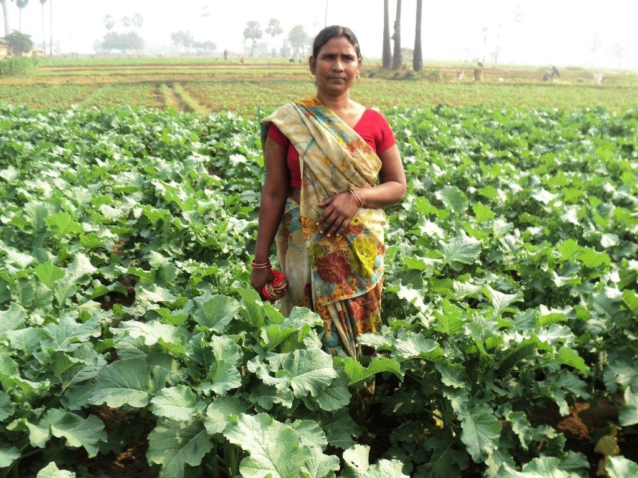
THANK YOU....
(Rapeseed fields)

