Slide 1
Club of Rome Summit
30th October 2014,
The Taj Palace, New Delhi
By: Dr Vibha Dhawan
Notes:
SAR: 1.6 B population; 1.1 B rural population; A-GDP (2010): 401.8 B; GDP Growth 2000-10: 7.1%; A-GDP Growth 2000-10: 3.1%

Slide 2

Overview
Framing the Challenge: what is needed from agriculture
Priority elements of action plan:
  Raising agricultural productivity
  Linking farmers to markets
  Reducing risk and vulnerability and raising rural non-farm incomes
  Enhancing environmental services and sustainability
  Food and nutritional security
Notes:
SAR: 1.6 B population; 1.1 B rural population; A-GDP (2010): 401.8 B; GDP Growth 2000-10: 7.1%; A-GDP Growth 2000-10: 3.1%

Slide 3

Needed from agriculture: More Food
+50%
  Food supply has lagged rising demand (2006-11)
    World grain consumption growth rate = 2.3%
    World grain production growth rate = 1.8%
  Climate change projected to reduce yields
    ~15-30% decline by 2050 without adaptation
  More competition for land & water resources
    25% of land is highly degraded
    Almost half of worlds’ population will live in high water stress areas by 2030
  ~85% of food produced in country of consumption
  ~85% of world population in developing countries
Food demand
9 billion people
7 billion people
2012
2050

Slide 4
Needed from agriculture: Higher Incomes
GDP growth generated by agriculture is at least twice as effective in reducing poverty as growth generated in other sectors
    75% of the poor live in rural areas
  ~500 million smallholdings, average size ~ 2 hectares
  Smallholder based growth has led to poverty reduction
    China – smallholder dominated: Doubled cereal yields in 1990s, 400 million people moved out of poverty
    Brazil – large-scale dominated:
    Doubled cereal yields, number of poor increased
Incomes need to be more resilient
Smallholders need to be linked to (higher value) markets
Source: World Development Report 2008

Slide 5
Needed from agriculture: Environmental Services
GHG emissions from agriculture are high but can be reduced
  Agriculture accounts for ~ 3% of global GDP growth, but 30% of GHG
  Need more climate-smart production systems
  More recognition of inter-linkages of natural capital (land, water, forest)
  New opportunities for payment for environmental services

Slide 6
Needed from agriculture: Improved Nutrition
Half of developing countries are seriously off track to halving undernourishment
(a Millennium Development Goal)
  Nutrition linked MDGs are lagging – undernourishment, child & maternal mortality
  870 million people are undernourished
  2 billion deficient in micronutrients
  Food production does not automatically translate into improved nutritional outcomes for specific groups
Source: World Bank Global Monitoring Report

Slide 7
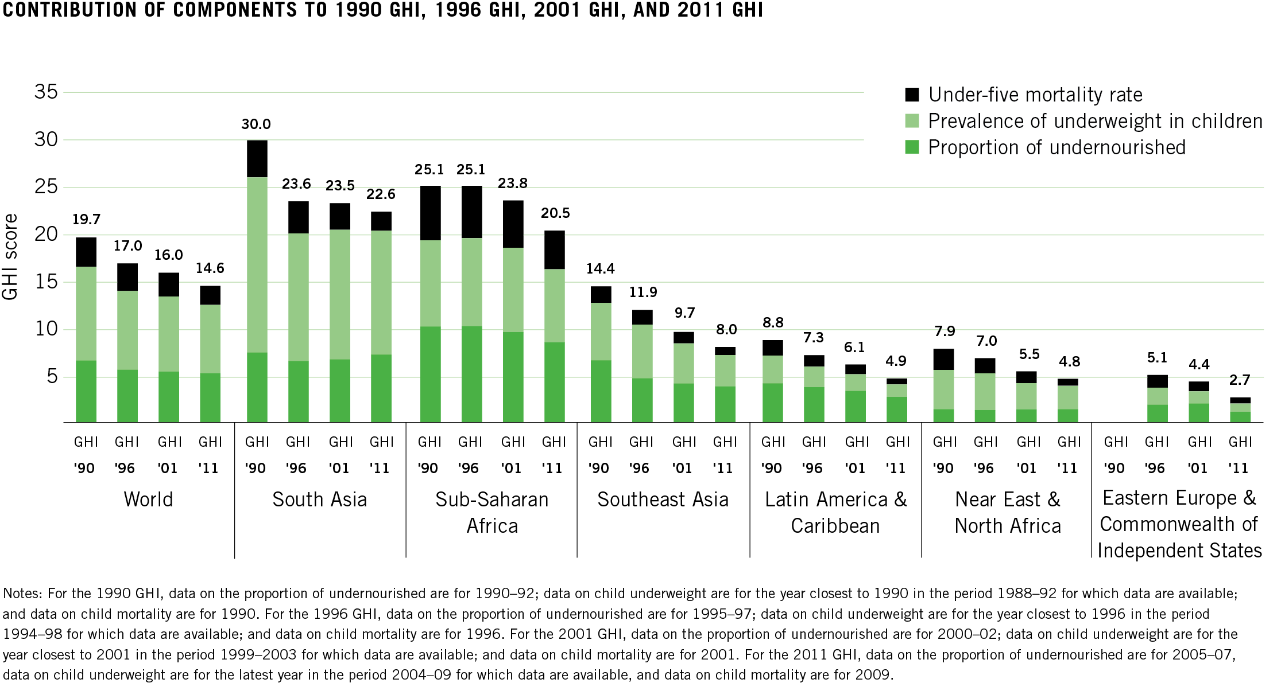
Food Insecurity: High concentration of hungry and undernourished persons
Global Hunger Index (IFPRI)
Notes:
1. GHI, due to IFPRI, comprises following equally weighted indicators: (i) Undernourishment (% population undernourished – insufficient calorie intake); (ii) child underweight: % children-under-five who are “underweight” (low weight for age, reflecting wasting, stunting, or both); (ii) child mortality: mortality rate of children-under-five. 0 is best score and 100 is worst.)

Slide 8
Thematic Focus
Maintain long-term focus on five thematic areas ….
In recognition of the evolving context give more emphasis to …
Raise agricultural productivity
Climate-smart agriculture
Link farmers to markets and strengthen value chains
Facilitate rural non-farm income
Private sector responses
Reduce risk and vulnerability
(with a cross-cutting focus on gender)
Longer-term risk management and improved resilience
Enhance environmental services and sustainability
Landscape approaches
More explicit nutrition focus
Notes:
Yield gains since 1961 avodied 13.1 gigatons of CO2 per year (approx 25% of current GHG emissions). Alternatively, 2.7 times more land would be needed to produce cereal crops today if no productivity gains since 1960. 10% drag on yields since 1980 from climate change
Climate Smart Agriculture = productivity (research, extension, input use, land tenure) + adaptation (drought/flood tolerant crops, water mmt, ecosystems management, early warning systems) + mitigation (improved livestock nutrition + feed management, better waste management in intensive livestock systems, water management in rice/crop production). Also, activities that enhance productivity-adaptation-mitigation jointly (mulching, minimum tillage, agor-forestry, soil carbon storage by plants)
Landscape approaches: inter-linkage of natural resources: balance between crop production, ecosystem services of forests, and water management, biodiversity
Nutrition: invest in women smallholders (productivity and time saving technologies); development + adoption of bio-fortified varieties (Iron in beans [rwanda], vitamin A in cassava [Nigeria, DRC] and sweet potato [uganda, mozambique]); facilitate food fortification in food processing; increase nutrition education and crop diversification
Risk management:
Monsoon risk: 80% water in 4 months; 60% area rain-fed; poor, smallholders
Livestock disease risk: rising, impacting small producers (Actions: Surveillance, enhanced disease diagnostics, disease reporting, prevention (including vaccination where possible), and control following ONE HEALTH framework)
Integrated sector risk management (production, market, enabling environment; associated responses)
Price risk: appropriate risk management instruments
Macro production risks: food reserve, trade policy, infrastructure to improve supply efficiency

Slide 9
Priority Themes
SAR Strategy
Activities
Agricultural productivity
Lagging regions, ag. productivity, improve accountability & service delivery
Innovation systems, irrigation & water mgmt.
Link farmers to markets
Private sector as growth driver, High impact infrastructure (incl. urban areas)
Policies, Producer groups, value chains, input markets
Risk & vulnerability
Better targeted social protection, CC impacts (adaptation and mitigation)
Livelihoods, risk instruments, safety nets
Rural non-farm income
Business environment; Skills, incl. gender equality; regional cooperation
Enterprise, skills & employment, finance
Env. services & sustainability
Env. health, NRM, mitigate impact of natural disasters, impact of CC
Soil health, watershed mgmt., carbon finance,
Notes:
1. Climate Smart Agriculture Goal: sustainable ag productivity gains, strengthened farmer resilience, reduced GHG and increased carbon storage through agriculture
2. Operational Model:
Innovate: pilot new ideas, innovative approaches, institutional alternatives
Demonstrate: proof-of-concept, evaluate impact
Consolidate and scale-up: transformative impact: within large countries and across SAR to smaller states.

Slide 10
Raising Agricultural Productivity
Technology, Production, Water and Nutrient Efficiency

Slide 11
Pushing the Frontiers of Agriculture Technology
Raising agricultural productivity
Past Emphasis
The Way Forward
Top-down systems
Supply driven
Public sector focus
Focus on production
Innovation systems
Cutting edge knowledge intensive agriculture
Public-private-academia-civil society partnerships
Oriented to value chains
Greener options: bio-control, bio-nutrients

Slide 12
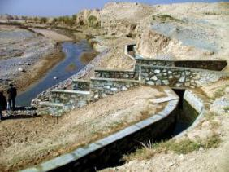
Actions on Water
Raising agricultural productivity
Past Emphasis
The Way Forward
Expanding irrigation systems
Bricks and mortar
Focus on water institutions.
Addressing policies & regulations
Grassroots institutions for better management
Water efficient technologies (ICT based, drip, etc.)
Linking water and agriculture institutions
Notes:
As I showed earlier with the maize example, water is critical to increased productivity. About 80% of freshwater withdrawals in South Asia go to agriculture. We need to change this, so we’re now emphasizing
Policies, institutions, and technology to manage the water we have

Slide 13
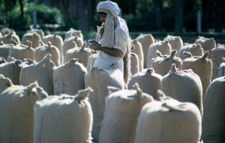
Actions to Increase Market Access & Efficiency
Link Farmers to Markets
Past Emphasis
The Way Forward
Neglected area
Rural Roads
Some market infrastructure
Implement policy reform
ICT for market information
Modern marketing infrastructure
Product quality & food safety
Commodity groups, producer companies
Wholesale market governance

Slide 14
South Asia Likely to be Worst Affected by Climate Change
Environmental Services & Sustainability
2050: average yields will decline from 2000 levels by:
50% for Wheat
17% for Rice
6% for Maize
Notes:
Weather contributed to 3 world food spikes in last 5 yrs, driving more people into hunger and poverty
At 2 degree warmer, yields could decline by 15%
Goal: sustainable ag productivity gains, strengthened farmer resilience, reduced GHG and increased carbon storage through agriculture

Slide 15
Actions for Climate Smart Agriculture
Environmental Services & Sustainability
Past Emphasis
The Way Forward
Technology and irrigation infrastructure: still relevant to CC agenda
Less focus on resource use efficiency
Priority to expanding food production: food security
Participatory watershed management
Use technology mix (biotechnologoy, new breeds, check dams to satellite monitoring)
Realign incentives for nutrient management
Precision farming, integrated agriculture, etc.
Conservation agriculture: reduce emissions, carbon sequestration

Slide 16
A multi-sector challenge
Policies, regulations, subsidies
Political economy Issues
Rural Roads
Safety Nets and Services
Climate Change and Disaster Preparedness/Response
Gender sensitive agriculture
Vocational training
Social protection and safety nets
Pricing, subsidies, land titling, biotechnology
Access to services
Efficient Energy solutions
Resource efficiency
Financial Services,
Nutrition and health
Increasing knowledge
Regional Integration: food security
Energy-Agriculture-Water-Climate nexus

Slide 17
Borlaug Institute for South Asia (BISA) A New Initiative for Food and Nutrition Security in the Region

Slide 18
South Asia – Current Scenario
Green Revolution of 1960s saved ~1 b people from hunger in South Asia
Thanks to Dr Borlaug, the polity, the bureaucracy, the scientists &
most importantly the farmers of SA
Enormous progress since then &
Yet Today, South Asia with ever increasing population has:
  35% of world’s malnourished people
  Every third child born is underweight
  Strained Natural Resources - unsustainable
  Stagnating annual crop yield
  No scope for area expansion - 94% of total arable land is used for cultivation
    Global Warming - 30% of wheat & 15% of maize are likely to be lost by 2050
  Poor Technology dissemination – need for efficient TOT-ICT
  Wide gaps in technological advancement among the countries of SA &
  Low investment in Ag R&D
  Far away from meeting zero hunger challenge
  BISA was launched in 2011 to accelerate R4D in SA

Slide 19
Rio +20
UN Conference in 2012 on Sustainable Development Called for:
‘promoting, enhancing and supporting a more sustainable agriculture that improves food security, eradicates hunger and is economically viable, while conserving land, water, plant and animal genetic resources, biodiversity and ecosystems and enhancing resilience to climate change and natural disasters’.
8 Nos. of Millennium Development Goal : Zero hunger challenge-
100% access to food all year round
Zero stunting in children < 2 years old
Sustainability of all food systems
100% increase in smallholder productivity and income
But we are far away from the MDG
  BISA was set up in 2011 to catalyse agricultural R4D in SA

Slide 20
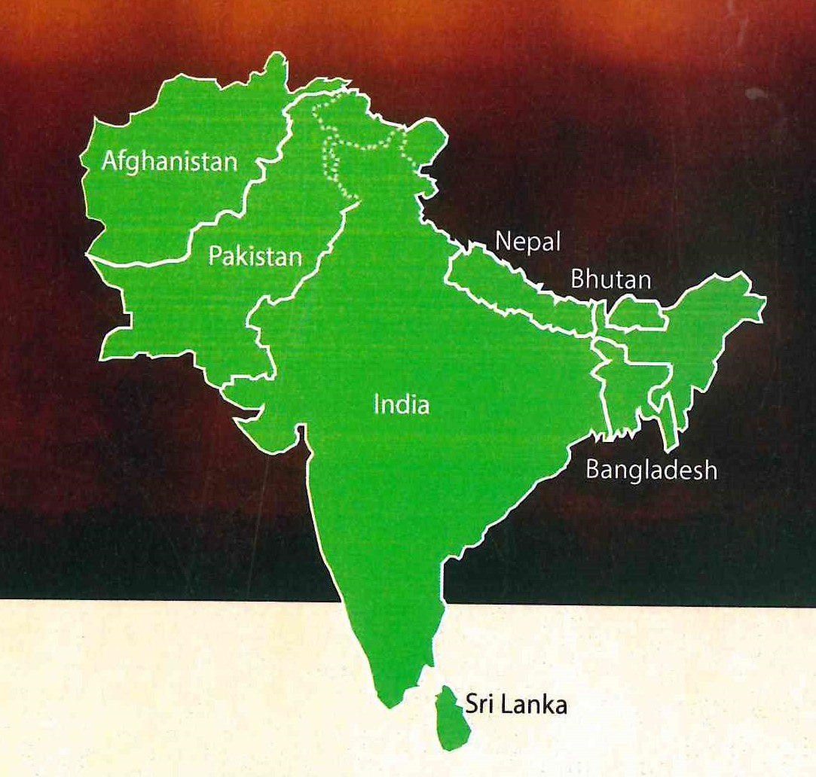
Mandated Area
All the 7 countries are agri. - based
economy & need R4D in agriculture

Slide 21
Sustainable Intensification
Rice-Wheat, Cotton-Wheat, Maize-Wheat – Major Cropping systems
13 million ha area under rice-wheat system in South Asia
Food bowl of the region- mining nutrients for the last 50 yrs.
Showing sign of natural resource fatigue
How to increase system productivity in sustainable manner?
BISA’s intervention: Sustainable Intensification
  Additional crop of legume in R-W with short duration cvs of rice- poor adoption because the produce gets caught in rain, labour intensive
  We made it possible by:
    relay seeding of green gram in wheat with last irrigation- Additionally, it reduces the adverse effects of terminal heat (saves 20-30% loss), crop matures 20 days early and thus saved from rain
    by relay seeding of green gram in standing crop of cotton helps to raise it successfully

Slide 22
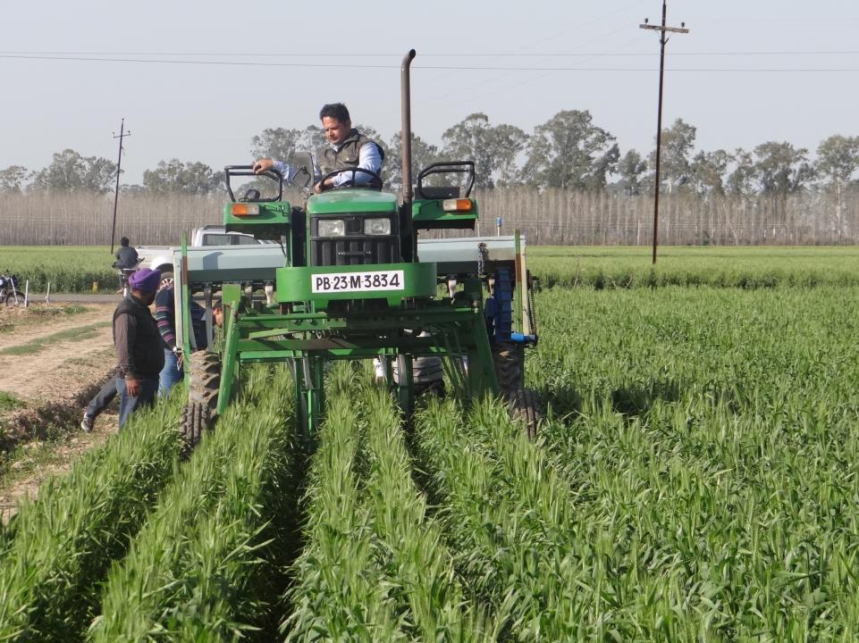
Sustainable intensification- contd

Slide 23
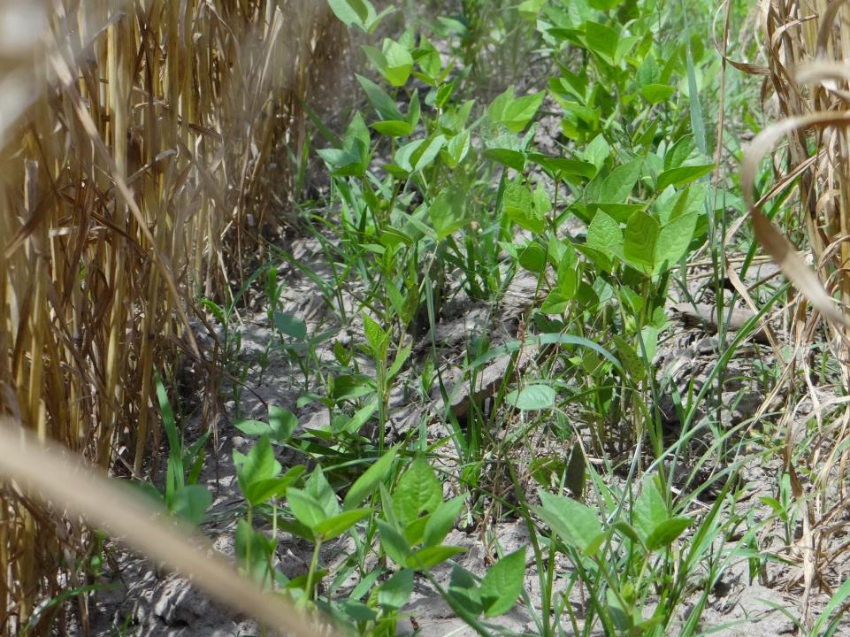
Sustainable intensification- contd

Slide 24
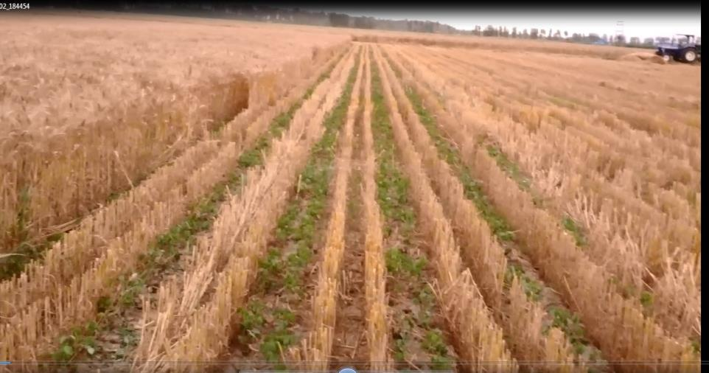
Combine Harvested wheat Field with Relay moong

Slide 25
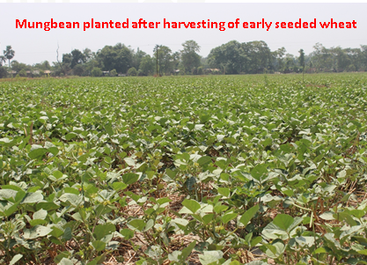
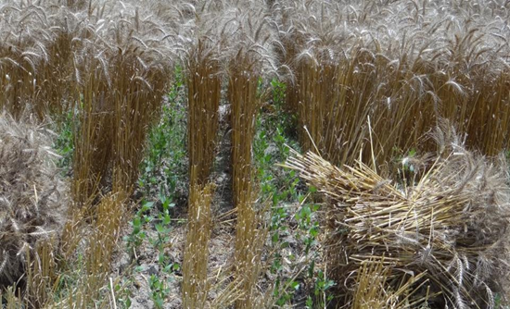
Sustainable Intensification- contd
Relay seeded green gram with HCL and Relay planter
  Impact: Pulses in 4-6/10 Mha will give 3-5 MT of pulses and will help
    Reduce protein malnutrition
    Make India self-sufficient in legumes & can save Forex ~2 billion US $
    Help Soil health improve thru N fixation and residue incorporation
    Improves carbon foot prints of Rice-wheat system

Slide 26
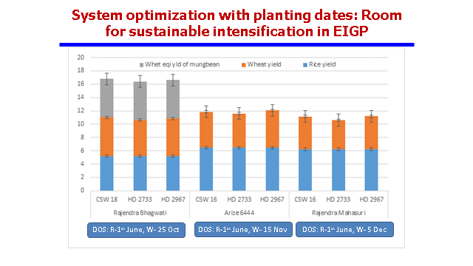
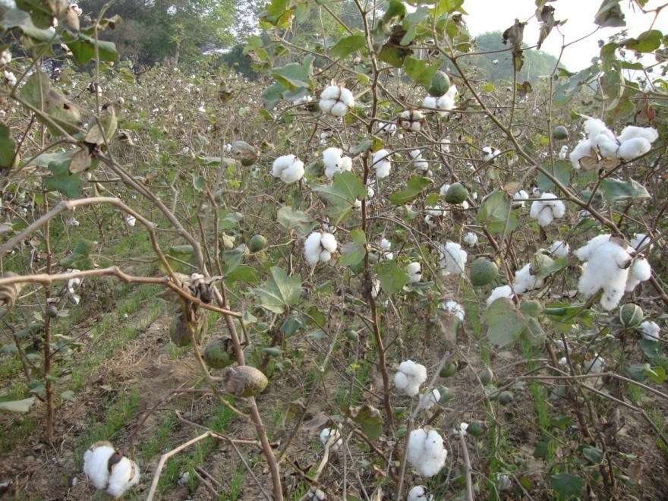
Sustainable Intensification of Rice-Wheat & Cotton-Wheat Systems
Introduction of Mung bean in R-W Cropping
Relay Planting of wheat, Ludhiana
Wheat productivity gains ~ 1.5 t/ha
Cotton gains 10-15 %

Slide 27
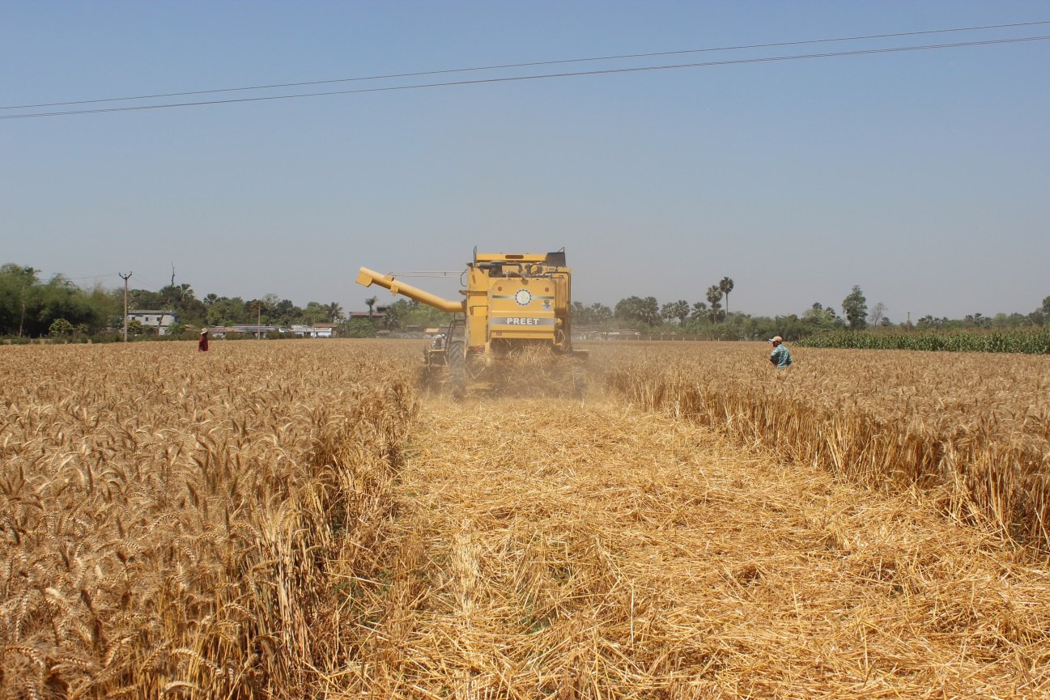
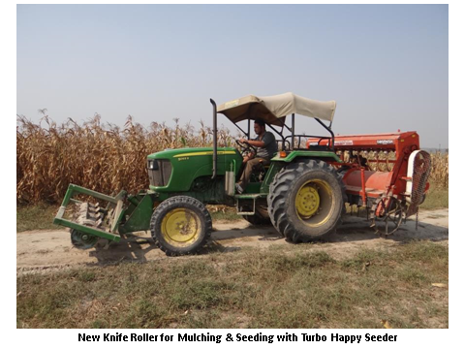
CA Machinery Developed/Modified
Straw Management during wheat harvest

Slide 28
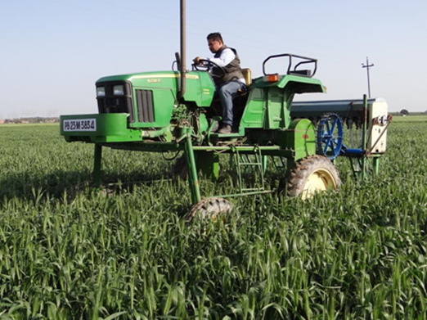
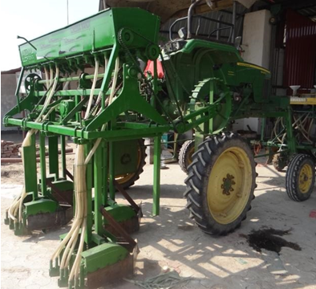
New Planting System for Relay Seeding
High Clearance Tractor
PAU –BISA – Private sector effort

Slide 29
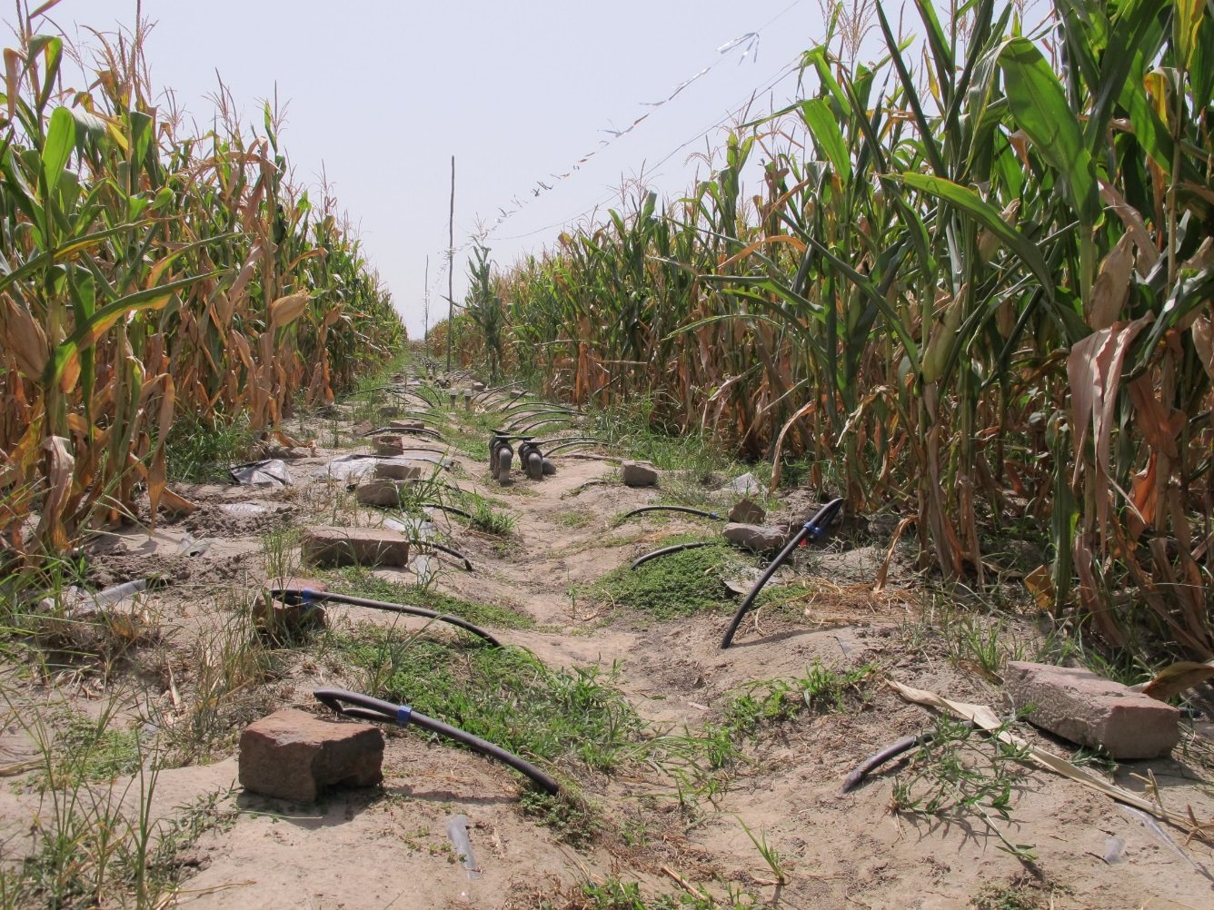
Increasing nutrient & WUE through
subsurface fertigation

Slide 30
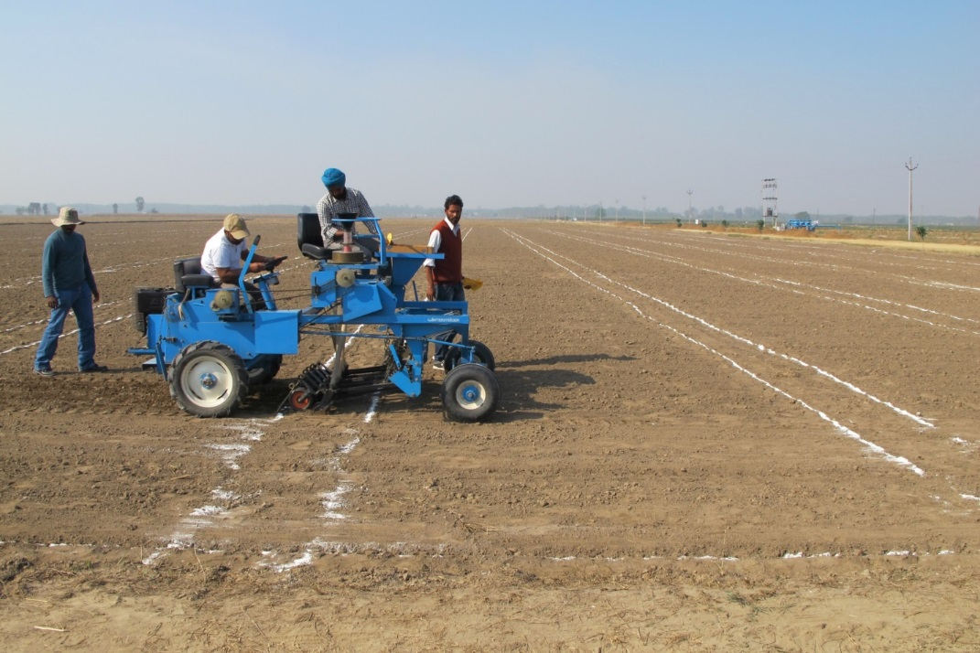
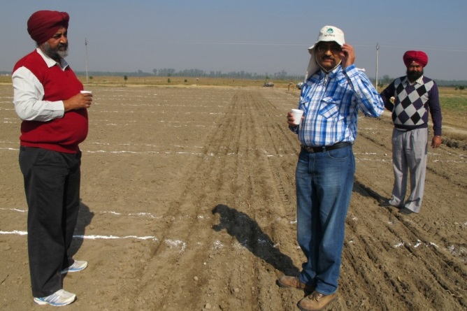
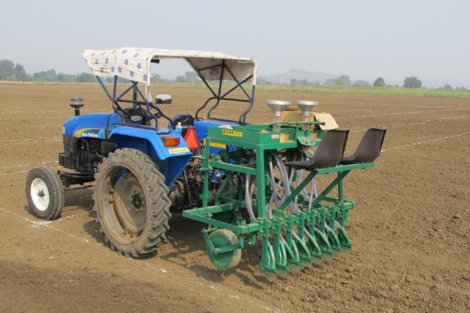

KSU – Cornell – CIMMYT BISA Project
Rapid Development of Climate Resilient Wheat Varieties for South Asia using Genomic Selection

