Slide 1
Global Conference – Securing Food for All
Critical Need for Coherence in Policies and Action
Club of Rome - Indian National Association
New Delhi, 30 October 2014
Achieving the Zero Hunger Challenge
Prof M S Swaminathan, FNA, FRS
UNESCO Chair in Ecotechnology, MSSRF, Chennai

Slide 2
Dimensions of Zero Hunger Challenge
Farming is the world’s largest private sector enterprise
Only 55% of global crops go to nourish people
48 million Americans rely on food assistance
Rice is Earth’s most important food crop
65% of Africa’s labor force works in agriculture
Nearly 100% of all biofuels come from food crops
Half of all food waste in the UK comes from private homes
One in eight people – 805 million worldwide – goes to bed hungry every night
Source : National Geographic

Slide 3
Malnutrition in Young Children
According to NFHS-3, ~45% of children in India under 3 years were stunted and undernourished
One in 3 malnourished children live in India
Under-nutrition is associated with half of under-5 deaths worldwide
Long-term effects of early malnutrition include cognitive and physical growth deficits across multiple generations and reduction in immunity to infections and childhood vaccines
  Richard SA Clin Infect Dis 2014, NFHS 3,

Slide 4
Disease Management : Need for a Food-cum-Drug approach
Good nutritional status is the best “vaccine” against TB
Under-nutrition increases the risk of developing tuberculosis
  Using data from many countries, a significant log-linear relationship was found between low BMI and incidence of TB
  In India, TB is 4 times more common in the lowest socio-economic quintile than the highest
  ~55% of TB cases in India are attributable to under-nutrition: higher in rural areas and among scheduled castes and tribes
  The same is true in the case of other diseases like leprosy and HIV/AIDS
  Lonroth et al Lancet 2010, Bhargava et al NMJI 2014, Swaminathan NMJI 2014

Slide 5


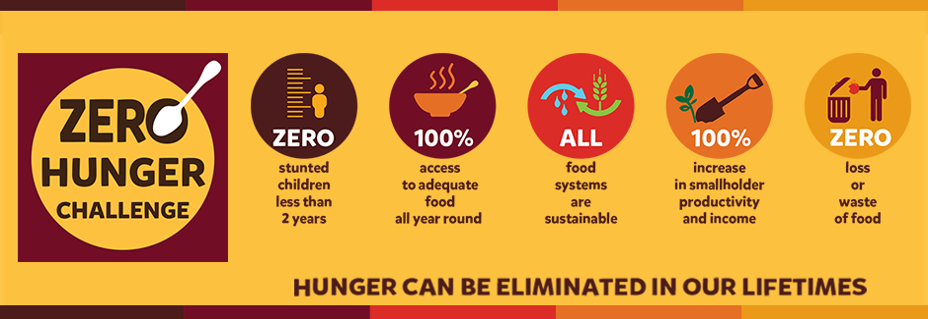
United Nations Secretary-General’s Vision (2012)
2025 : Target Year for Achieving Zero Hunger Challenge
Source: www.un.org

Slide 6
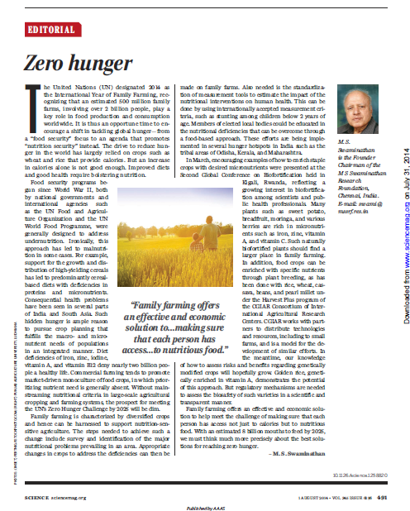
Zero Hunger
Science, Vol 345, 1 August 2014

Slide 7
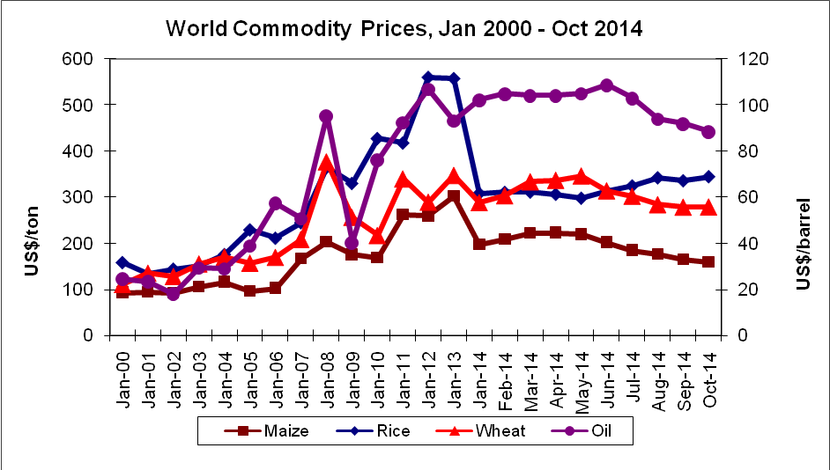
The Future Belongs to Nations with Grains and not Guns
Source : FAO, US Energy Administration and www.indexmundi.org and http://quotes.post1.org/historical-crude-oil-price-chart/ (data updated as on Oct-7-2014)
Price Volatility

Slide 8

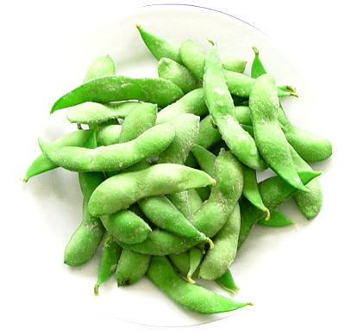
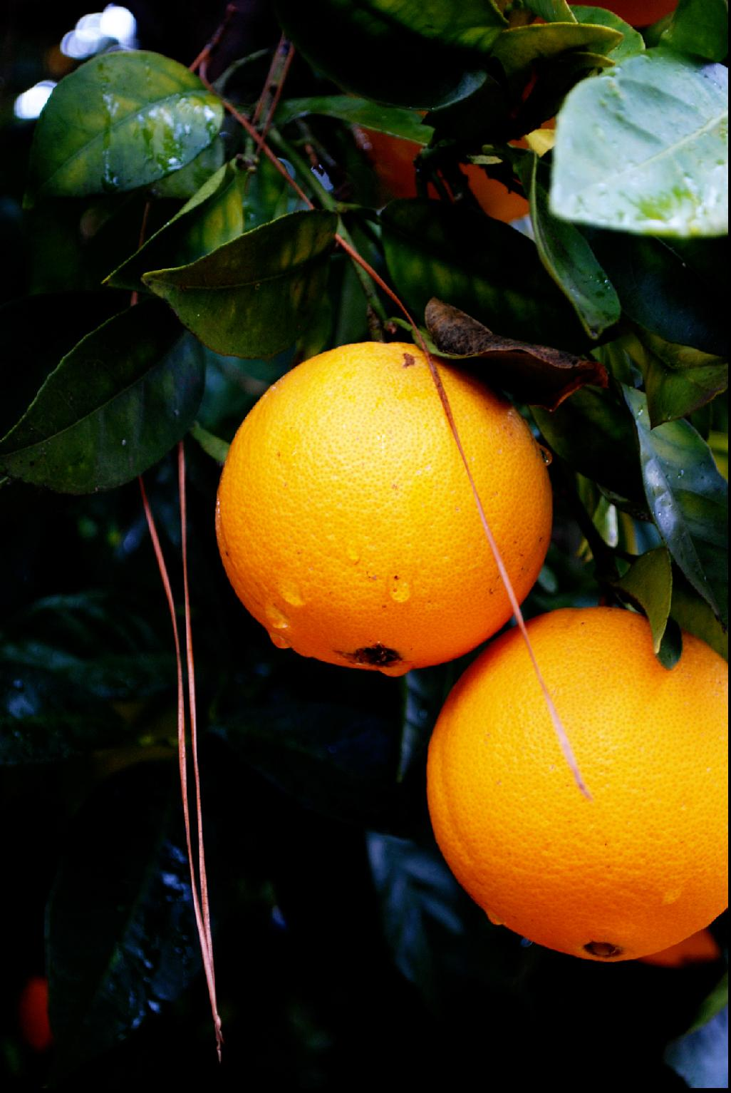
Three major dimensions of hunger
CALORIE
DEPRIVATION
PROTEIN
DEFICIENCY
MICRONUTRIENT
DEFICIENCY
Picture Source: Google images

Slide 9
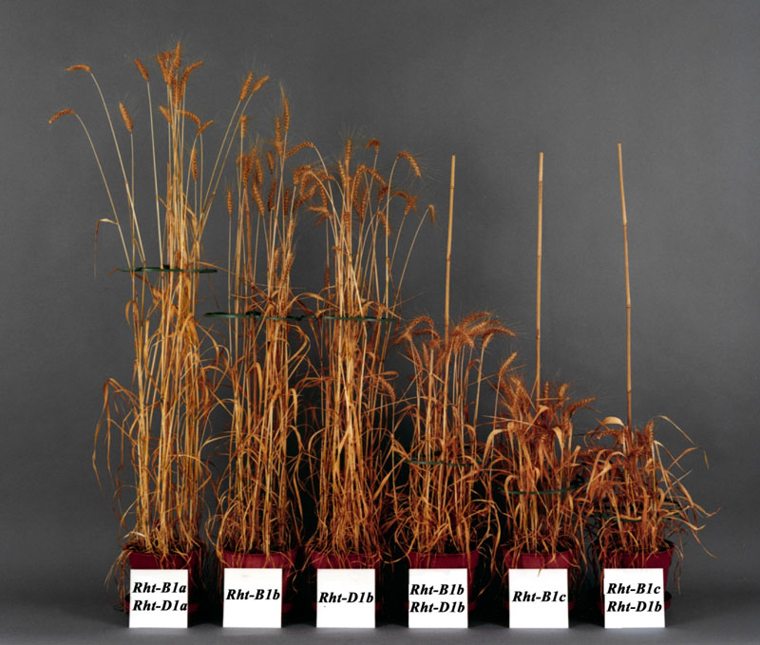
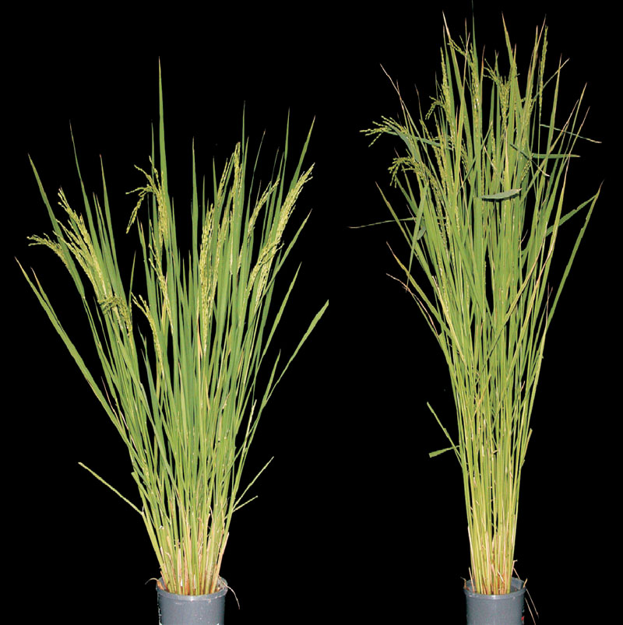
Overcoming Undernutrition:
The Green Revolution in Wheat and Rice
The effects of different Rht alleles on plant height in wheat (cv. April Bearded). The wild-type contains Rht-B1a and Rht-D1a, which are homoeologous (corresponding) genes on the B and D genomes. Rht-B1c is a more severe allele at the Rht-B1 locus
Comparison of woo-gen (right) and dee-geo-woo-gen strains, the latter containing the sd1 mutation
Source: http://5e.plantphys.net/

Slide 10
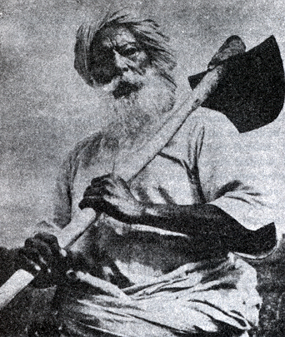
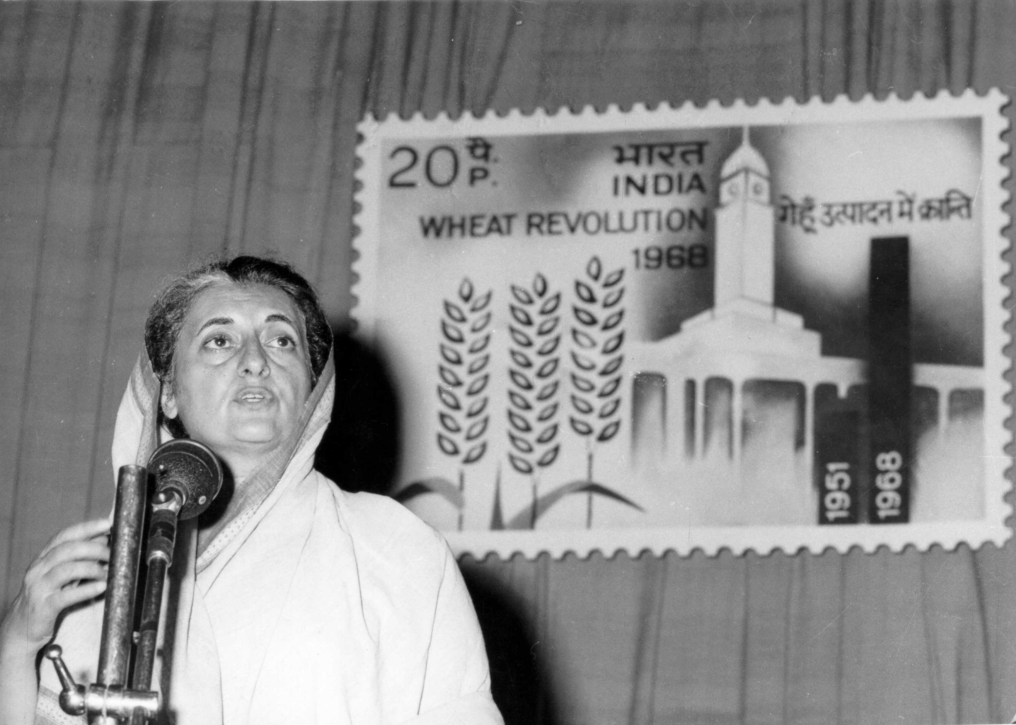
Green Revolution Symphony (1968)
Major Components
Technology
Services
Public Policies
Farmers’ enthusiasm
Indian farmers achieved as much progress in wheat production
in four years (1964–68), as during the preceding 4000 years.
Synergy among Scientific skill, Political will and Farmers’ toil
Notes:
10
10

Slide 11
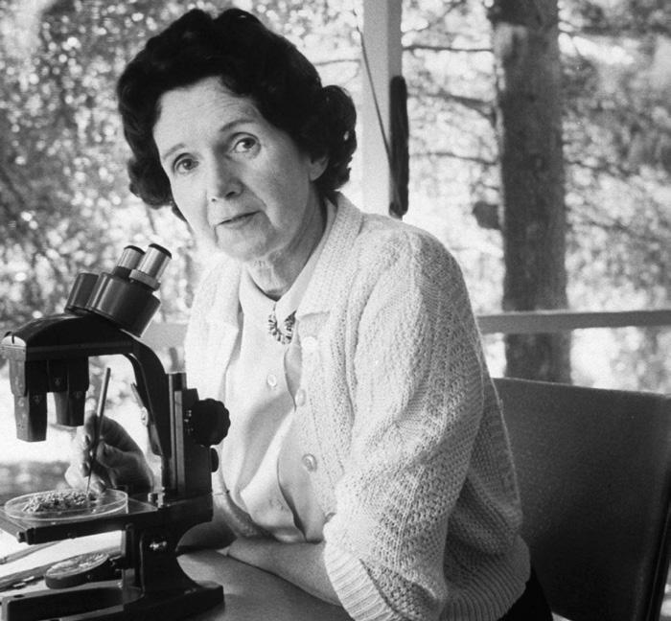
Rachel Carson 1962 : Silent Spring
“Man has lost the capacity to foresee and to forestall. He will end by destroying the earth”
- Albert Schweitzer
Sustainable Development : Early Warning

Slide 12

Evergreen Revolution is the Pathway
World requires 50% more rice in 2030 than in 2004 with approximately 30% less arable land of today
Securing Food for all and for ever will be possible only if the evergreen revolution pathway is adopted for enhancing yield

Slide 13
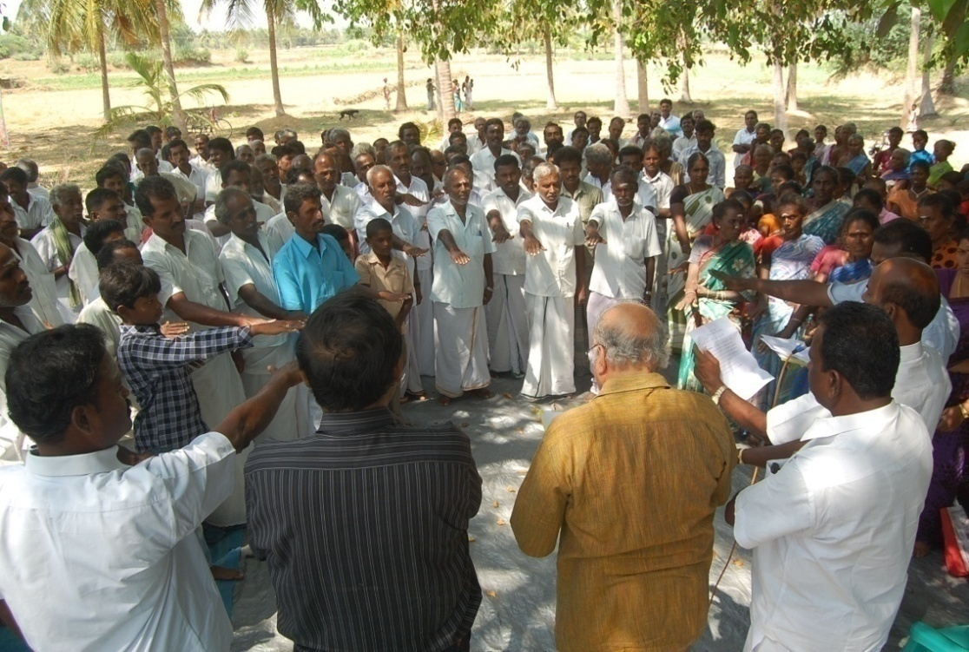
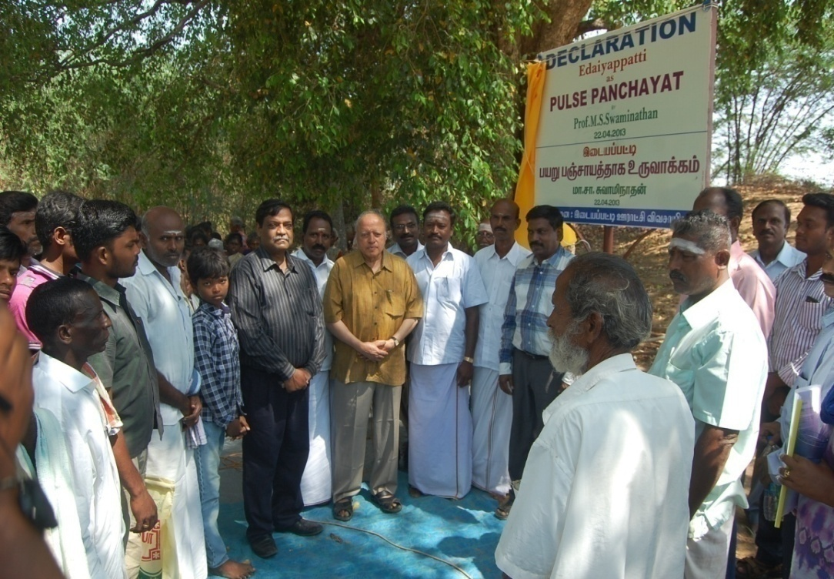
Overcoming Protein Hunger : Pulses Revolution
Pulses Panchayat - Edaiyappatti Village
2016: International Year of Pulses

Slide 14
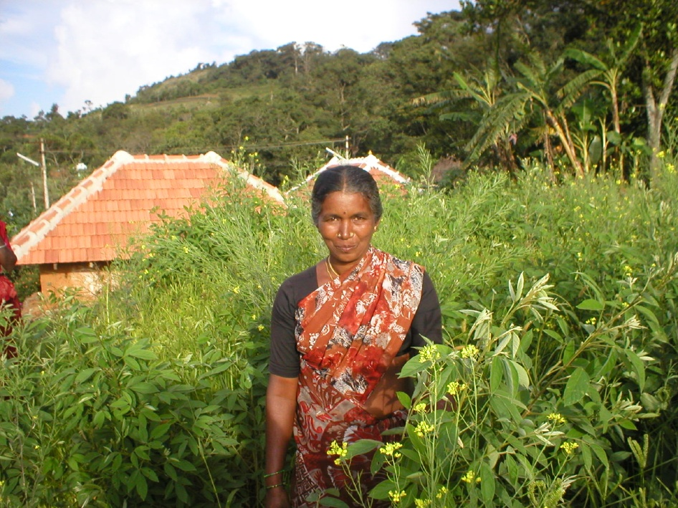
Biofortified Multiple Cropping System Kolli Hills, Tamil Nadu
Women play a keyrole in both the production
and consumption phases of farming

Slide 15
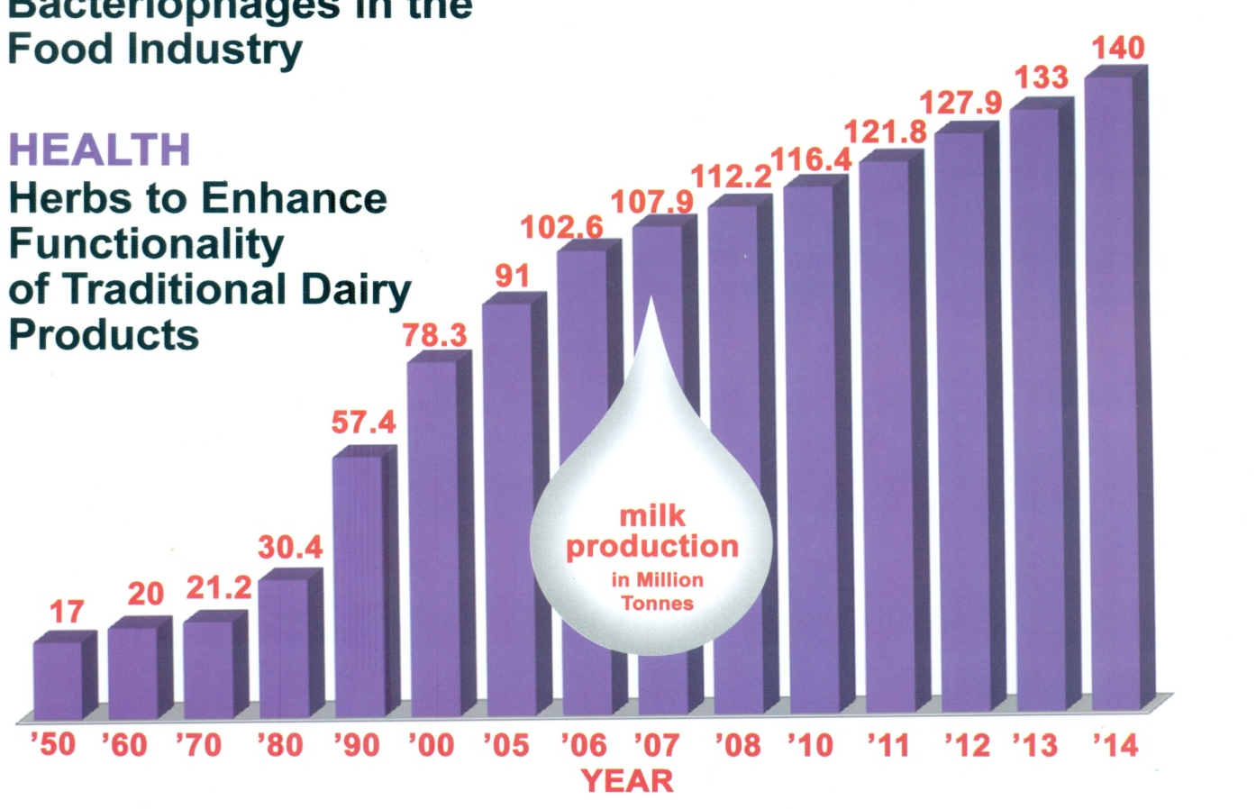
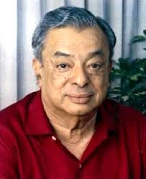
Growth of the Indian Dairy Industry
V. Kurien
Harnessing the power of Cooperatives
Source: Indian Dairyman & Google Image

Slide 16
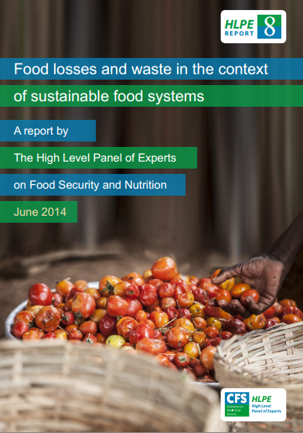
One of the main components of the Zero Hunger Challenge

Slide 17
Biofortification and Zero Hunger Challenge :
3 Major approaches
Cultivate and Consume
Naturally occurring biofortified plants like moringa, sweet potato, nutri-millets and fruits and vegetables, as well as milk, eggs and other forms of animal protein.
Biofortified varieties selected by breeding and selection, eg, iron rich pearl millet and zinc rich rice
Genetically biofortified crops like Golden Rice and iron rich rice (after appropriate regulatory clearance)

Slide 18
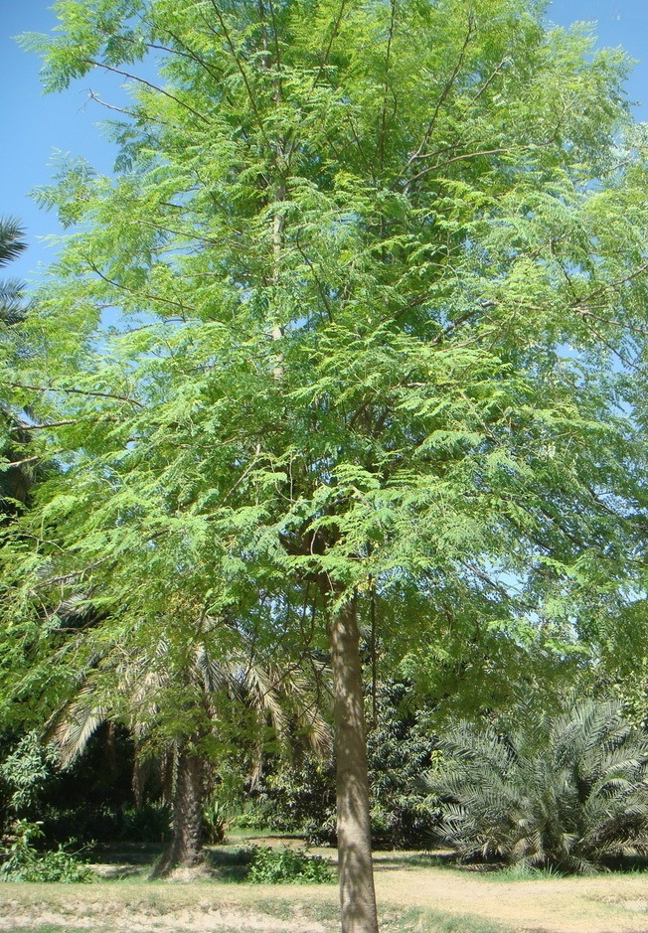

Role of Agro-forestry in Biofortification
Moringa Oleifera
25 x iron in spinach
17 x calcium in milk
15 x potassium in bananas
10 x vitamin A in carrots
9 x protein in yogurt
National Geographic, November 2012

Slide 19
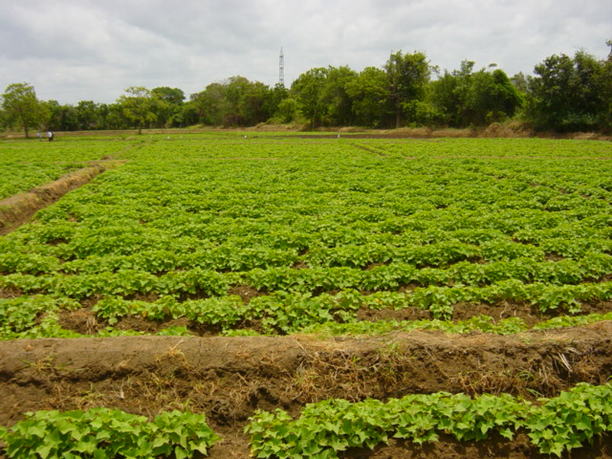
Orange-fleshed Sweet Potato Rich in Beta carotene

Slide 20
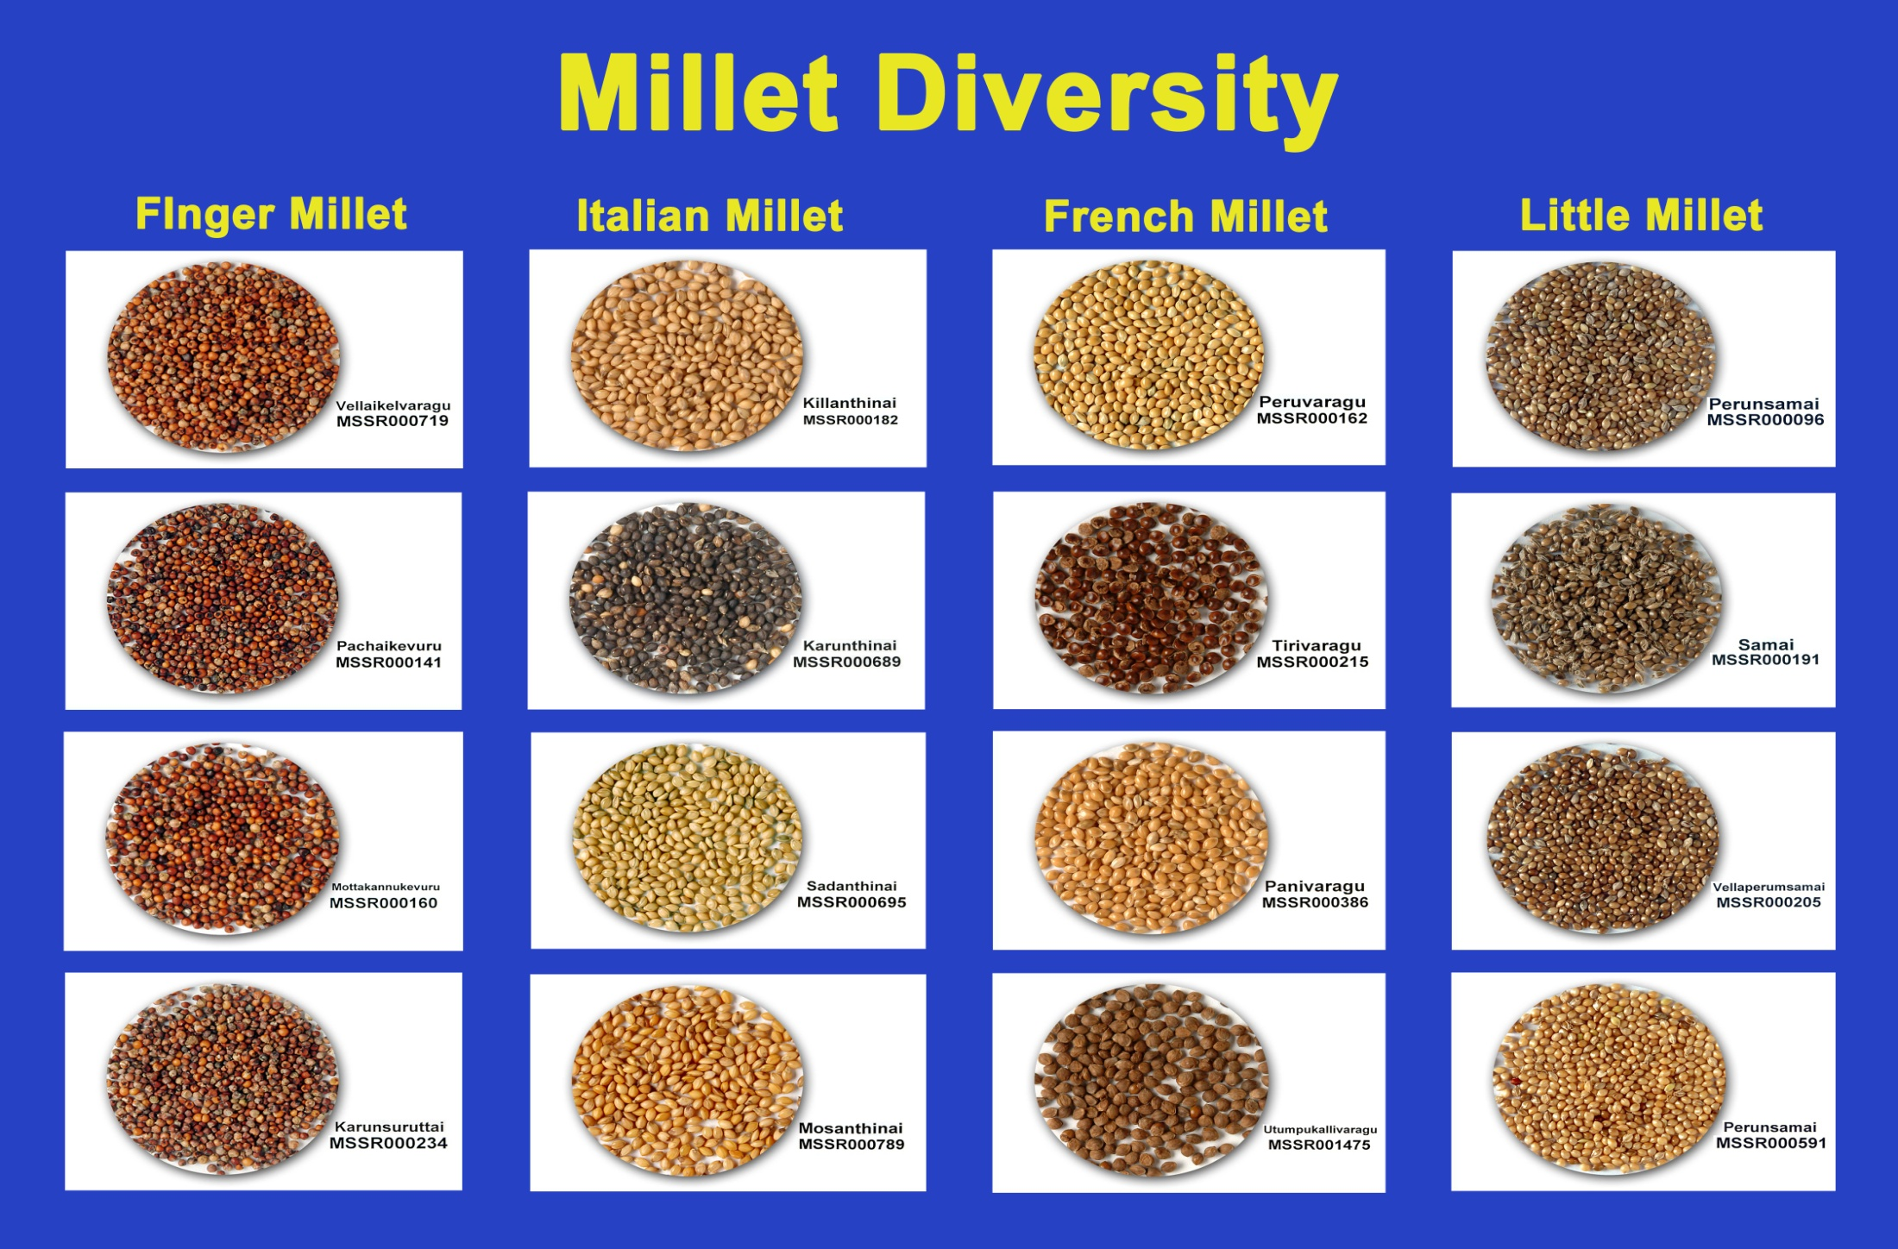
Rich in Nutrition; Climate Smart
Culinary Diversity

Slide 21
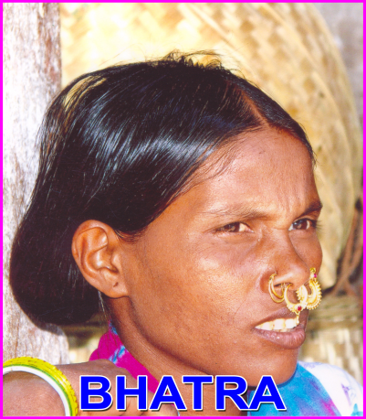

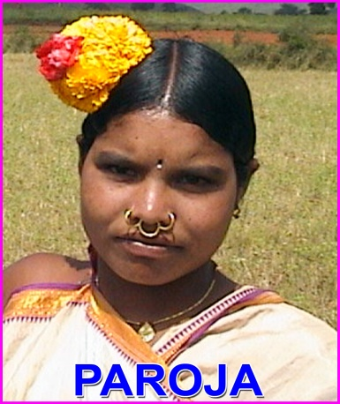

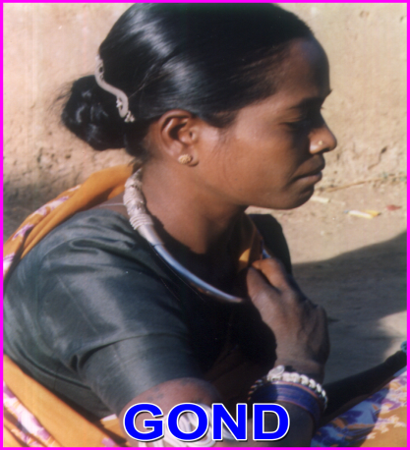
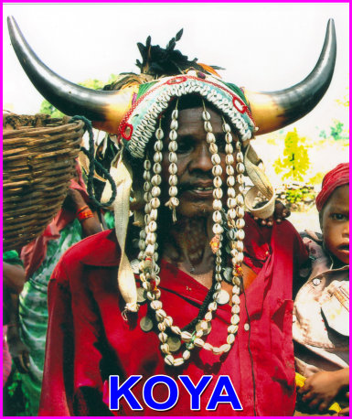

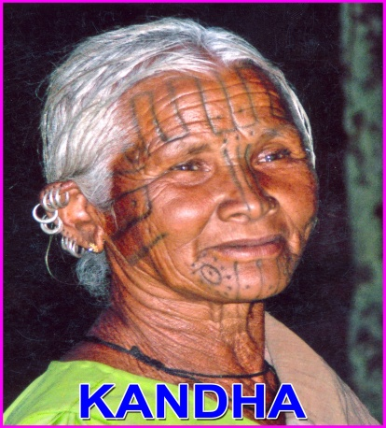
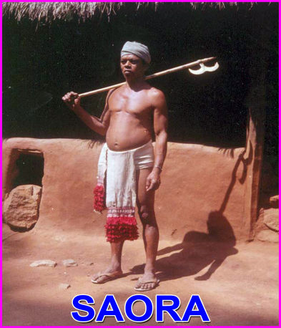
Farmers’ Rights :
Conserver, Cultivator, Breeder
Women and
Cultural & Curative Diversity
TRIBE | DISTRICT | Medicinal Plants used
Bhatra | Nawarangpur | 81
Bhumia | Koraput | 69
Bonda | Malkangiri | 55
Gadaba | Koraput | 83
Gond | Nawarangpur | 67
Kandha | Koraput + Rayagada | 124
Koya | Malkangiri | 48
Paroja | Koraput | 74
Saora | Rayagada | 59
9 tribes | 4 districts | 660 MPs
Genome Saviors
Tribal Families of Koraput, Odisha

Slide 22
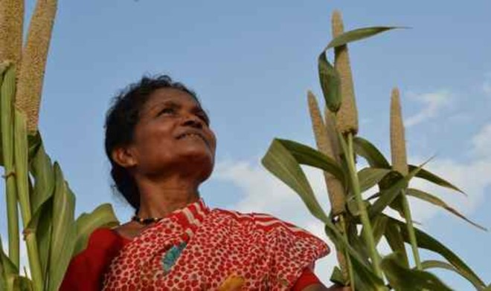
Combating California drought again : Revive Dying Wisdom and Vanishing Crops
Source : http://foodtank.com/news/2014/03/california-drought-time-to-rethink-forgotten-grains
Convert Calamity into an Opportunity

Slide 23
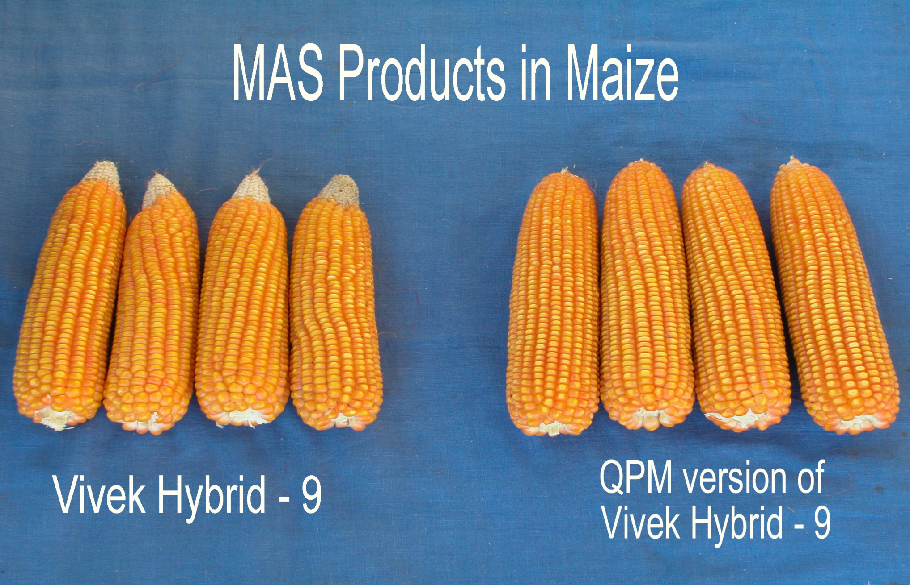
Quality Protein Maize
Source : Google Image

Slide 24
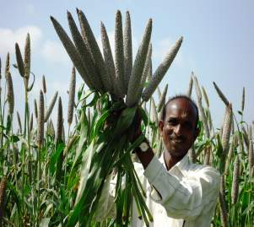
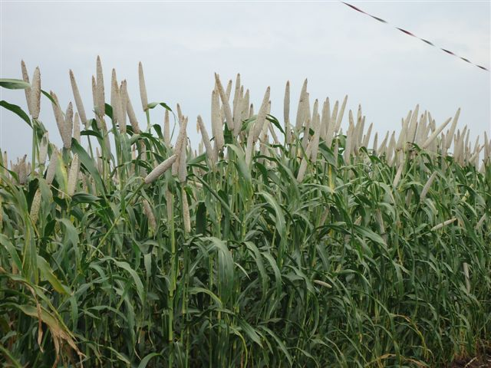
Biofortification through breeding:
High-iron Pearl Millet
ICTP 8203
ICRISAT-bred OPV
(70-74 ppm Fe)
With 10% Higher Yield
Marketed by NIRMAL SEEDS
86M86
Pioneer hybrid (54-64 ppm Fe)

Slide 25
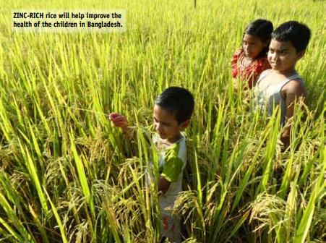
World’s first high-zinc rice released in Bangladesh
Source : Rice Today, Oct-Dec 2013, Vol12, No.4

Slide 26
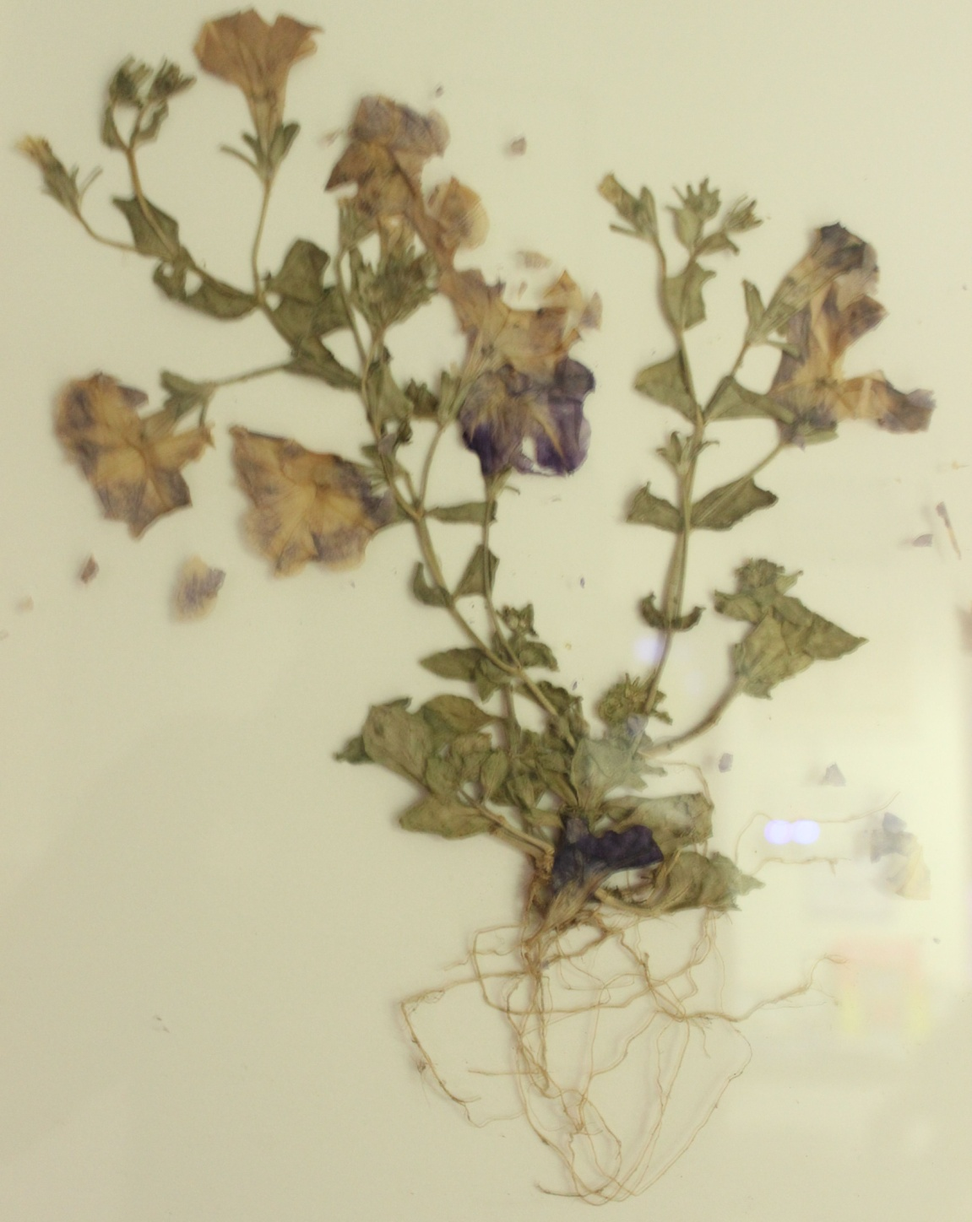
The beginning of Genetic Modification
First Genetically Modified Petunia (1983)
Source: Robert T Fraley

Slide 27
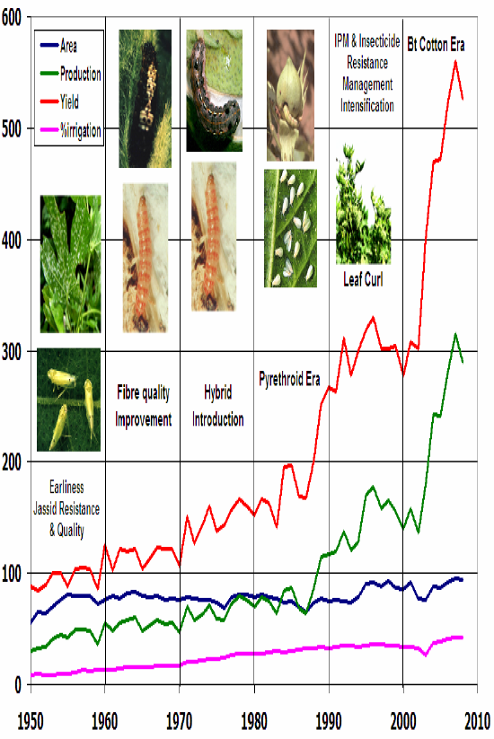
Impact of Bt Cotton in India

Slide 28
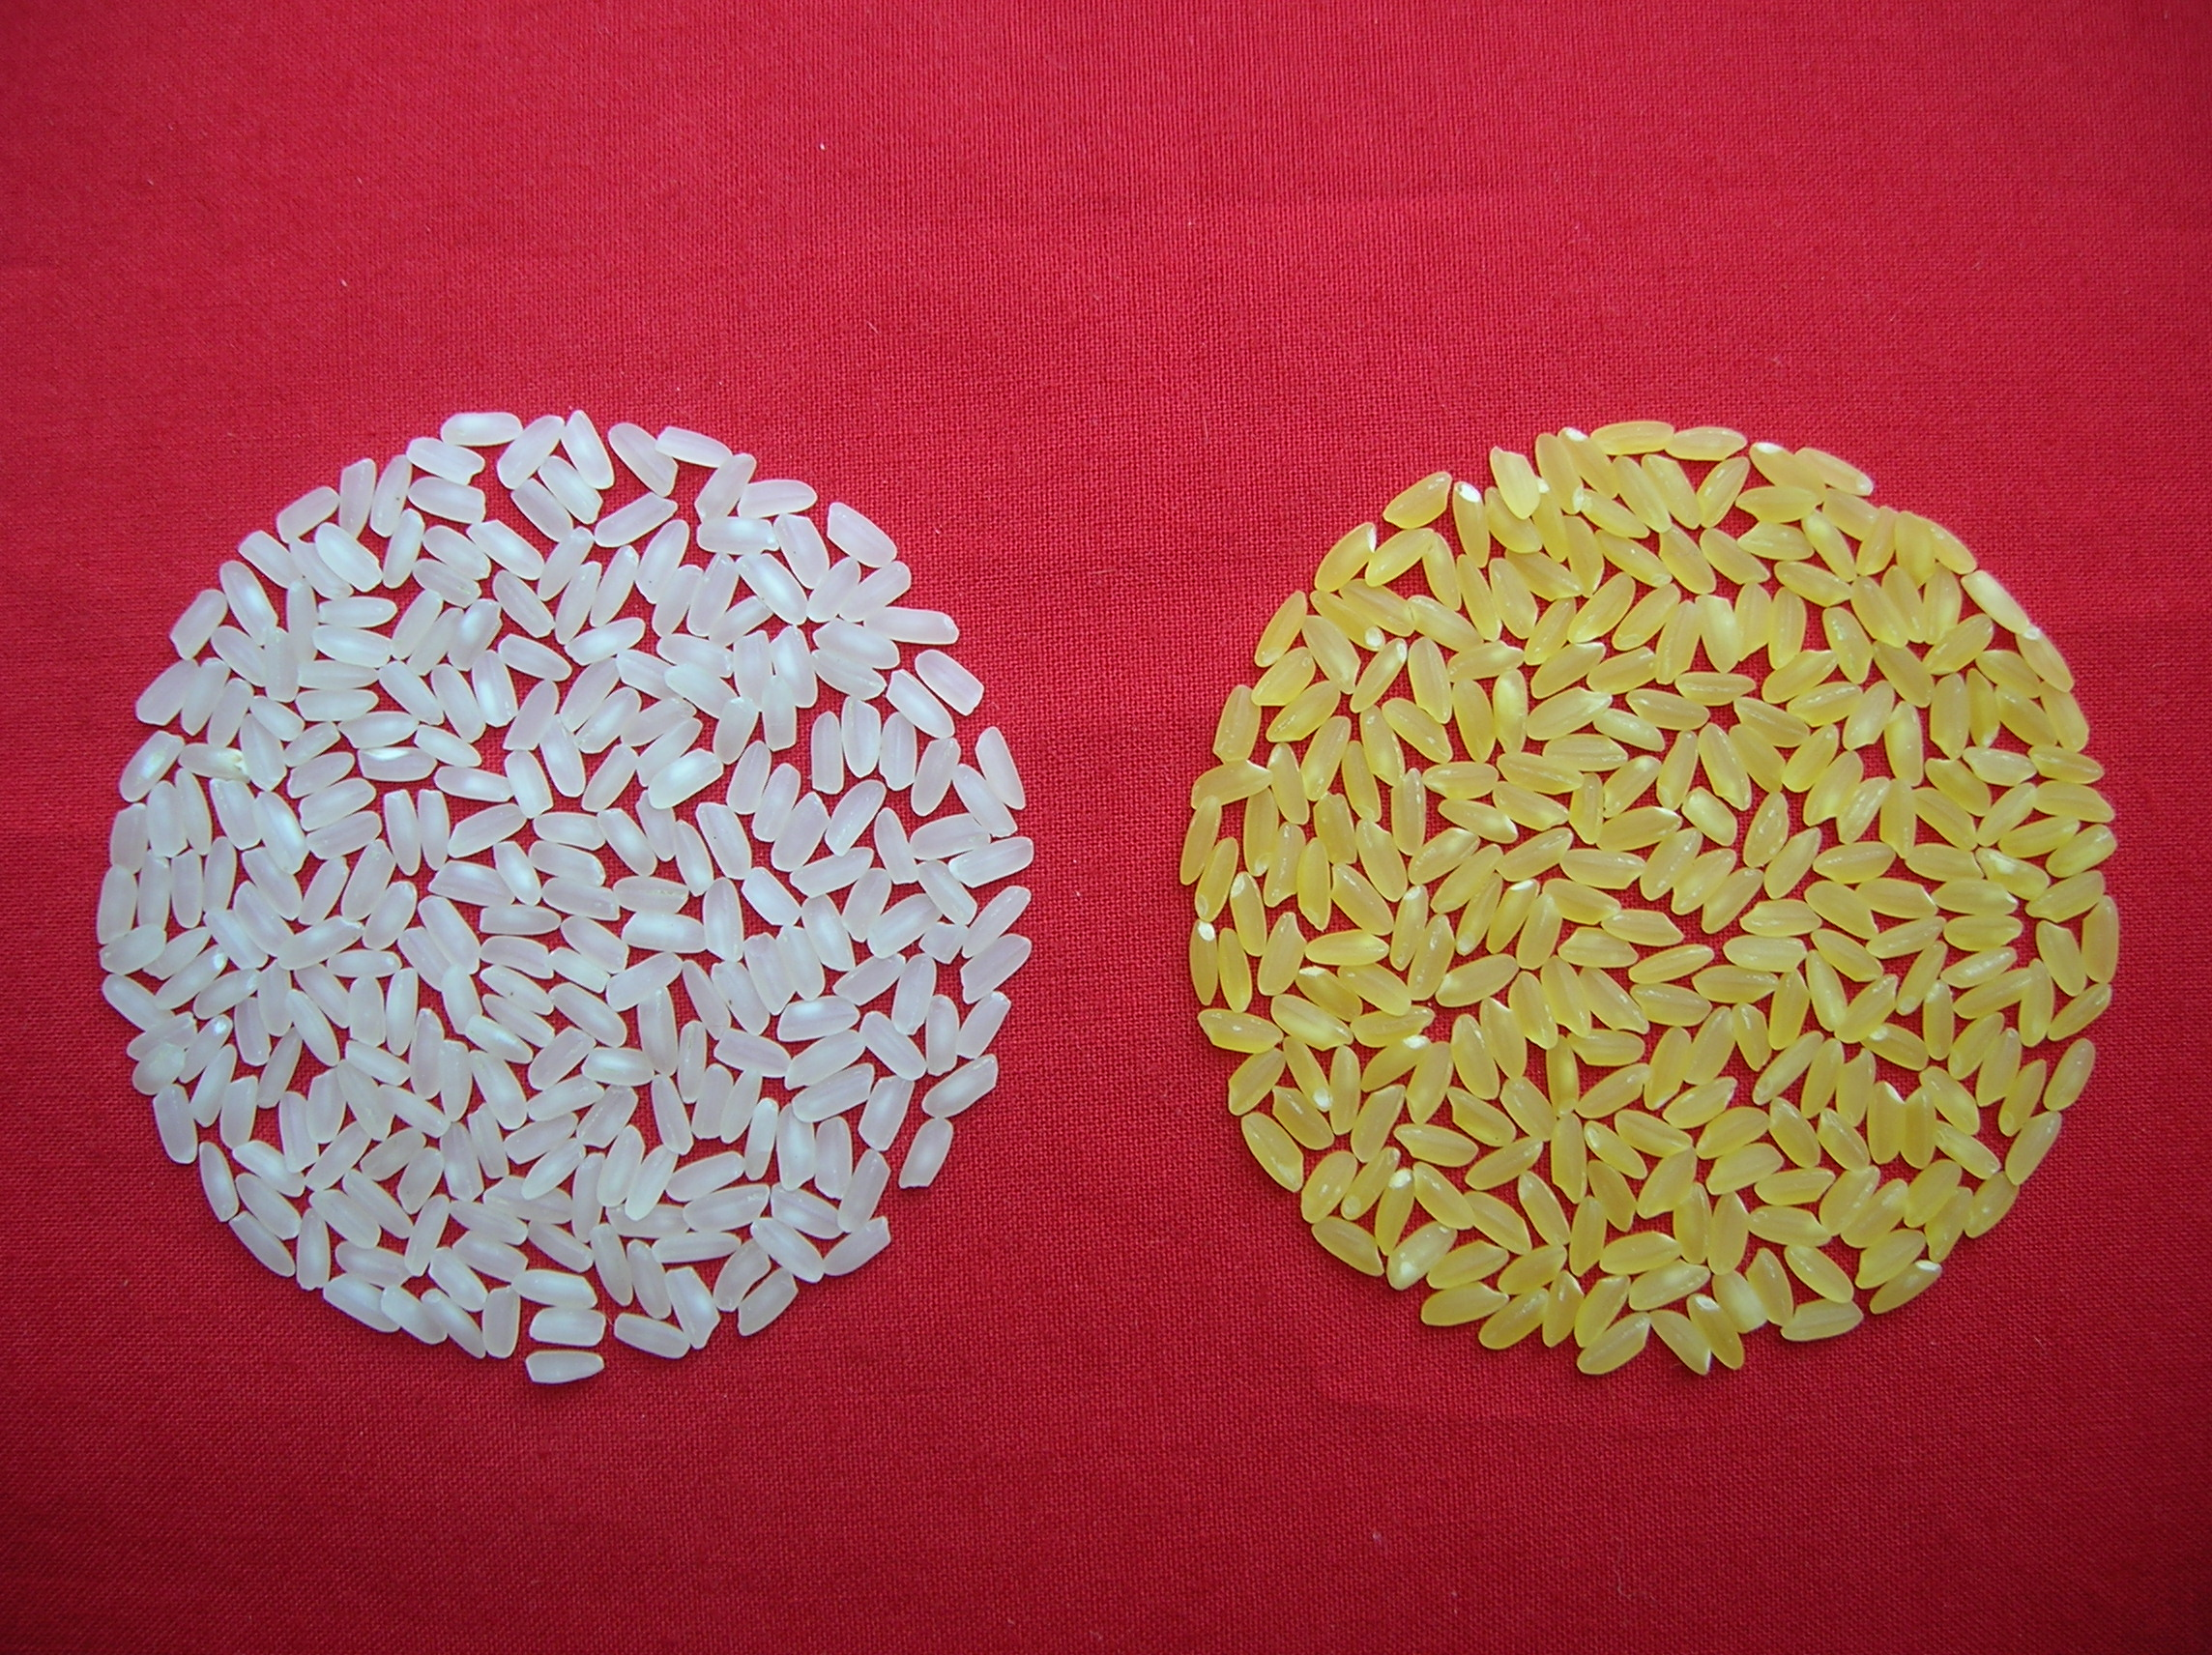
Genetic Modification : Golden Rice
Back cross derived lines in Swarna background using Kaybonet-GR2-R event as donor
Swarna
Golden Swarna
Source : IARI, New Delhi

Slide 29
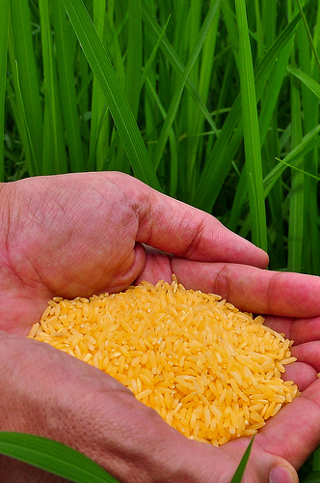
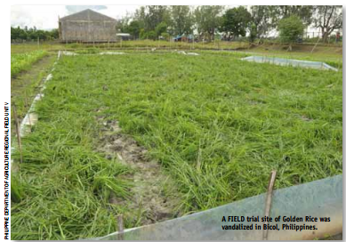
Golden Rice :
Trial Site Vandalized in Bicol, Philippines
Source: Rice Today, IRRI, Oct-Dec 2013, Vol.12, No.4
Establish Regulatory system which inspires public, professional, political and media confidence

Slide 30
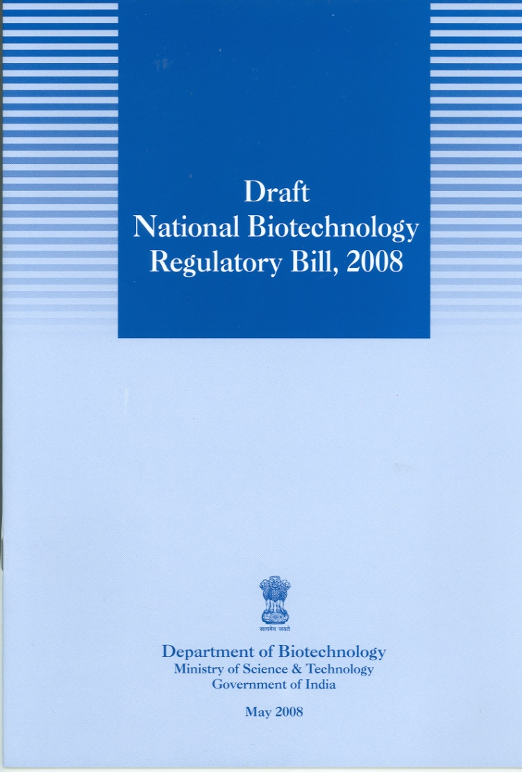
National Biotechnology Regulatory Authority
The bottom line of our national agricultural biotechnology policy should be the economic well being of farm families, food security of the nation, health security of the consumer, biosecurity of agriculture and health, protection of the environment and the security of national and international trade in farm commodities”
(M S Swaminathan Panel 2004)

Slide 31
Farming System for Nutrition (FSN)*
“FSN involves the introduction of agricultural remedies to the nutritional maladies prevailing in an area, through the mainstreaming of nutritional criteria in the selection of the components of a farming system involving crops, farm animals and where feasible, fish. While finalizing the components of a farming system, the gender and age dimensions of human nutritional needs are kept in view, such as the special needs of pregnant women and nursing mothers, and new born babies during the first 1000 days after conception and birth”. Biofortified crop varieties are introduced in FSN wherever available.
Agric Res DOI 10.1007/s40003-014-0119-5, 5 August 2014

Slide 32
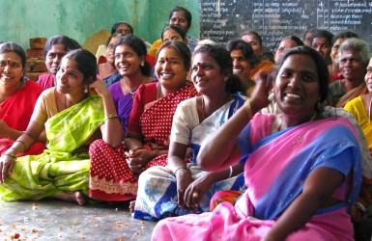
Role of Community Hunger Fighters in the
Zero Hunger programme
Become well-versed on the causes and cures for the endemic and hidden hunger prevailing in the village / town through a nutrition literacy programme
Identify and introduce agricultural remedies to nutritional maladies based on gender and age
Introduce in the farming system biofortified crops and varieties

Slide 33
From Ship to Mouth to Right to Food
National Food Security Act of India, 2013
Goal : To provide food and nutritional security by ensuring access to adequate quantity of quality food at affordable prices
Special Features :
Life Cycle approach with emphasis on the 1000 days of a child’s life
The senior most woman in the household will be designated the Head of the Household from the point of view of food entitlements
Enlargement of the Food Basket by including nutri-millets and other orphan crops in the Public Distribution System
Entitlement : Every person belonging to priority households shall be entitled to receive five kilogram of foodgrains per person per month at subsidised prices.

Slide 34
No Time to Relax : Major Challenges Ahead
Food losses and Food Waste
Climate change : scientific checkmating of adverse impact
Shrinking per capita land and water resources
Expanding biotic and abiotic stresses
Adverse cost-risk-return structure of farming
Market volatility
Reluctance of youth to take to farming
Controversies over genetic modification

Slide 35
Securing Food for All
The Human Dream
New Frontiers of the mind and technology are before us, and if they are pioneered with the same vision, boldness and drive with which the battle against food shortage was fought through the green revolution, we can achieve the goal of Food for All sooner than generally considered possible.
- Adapted from President Roosevelt’s American Dream

